Slide 1



Fish Stocks Forecasting using Linear Inverse Model
Gian Giacomo Navarra

Slide 2
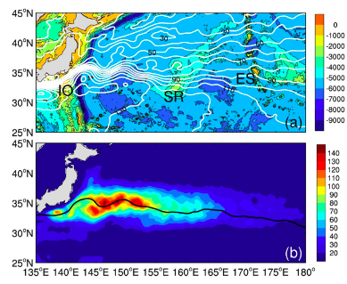
Kuroshio-Oyashio Extension (KOE)
AVISO
Mean Sea Surface Height & Topography
[meters]
AVISO
Mean Eddy Kinetic Energy
[J/m^3]
Yang et al. 2017
KOE is a hot spot for marine ecosystems dynamics and fish populations

Slide 3
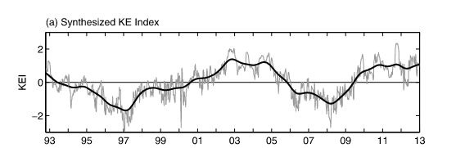
The Pacific Decadal Oscillation (PDO)
Climate modes such as PDO influence the KOE
(1) LOCAL Changes in Mixing
(2) REMOTE Propagation of Rossby Waves
KE Index
+ stable state
- unstable state
Stable State = Stronger KOE eastward transport and shift to the North

Slide 4
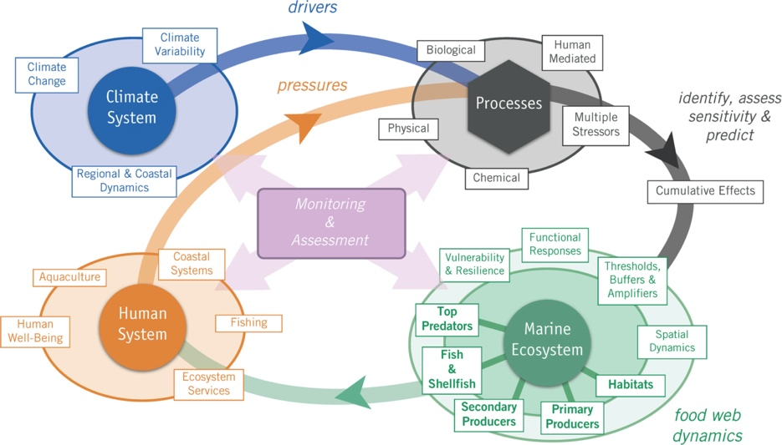
Why is it important?
(Bograd et al. 2019) The North Pacific Social–Ecological–Environmental System (FUTURE schematic).

Slide 5

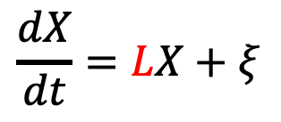
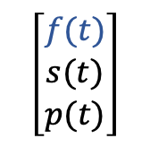
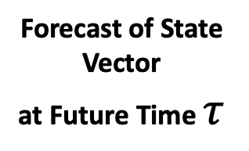
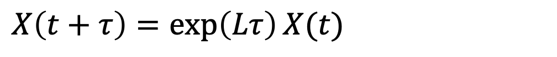
An Empirical Dynamical Model to Forecast Fish
$$\left[\begin{matrix}f(t) \\ s(t) \\ p(t)\end{matrix}\right]$$
Fish Indicators
State Vector of the Model
$$X=$$
SST
SSH
Linear Inverse Model
$$\frac{dX}{dt}=LX+ξ$$
Dynamical Operator Matrix
$$L=τ^{−1}\ln\left(<X\left(t+τ\right)X\left(t\right)> {<X\left(t+τ\right)X\left(t\right)>}^{−1}\right)$$
Forecast of State Vector
at Future Time $τ$
$$X\left(t+τ\right)=\exp\left(Lτ\right)X(t)$$

Slide 6
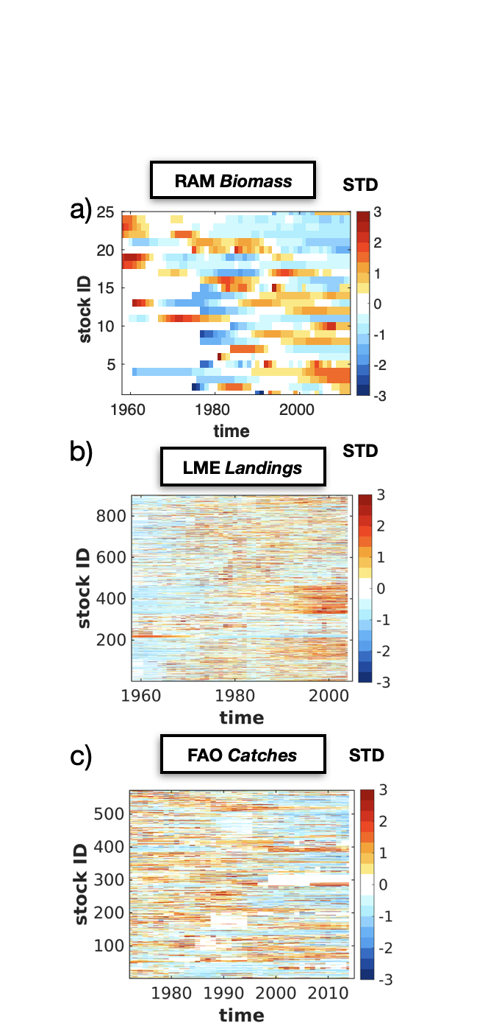
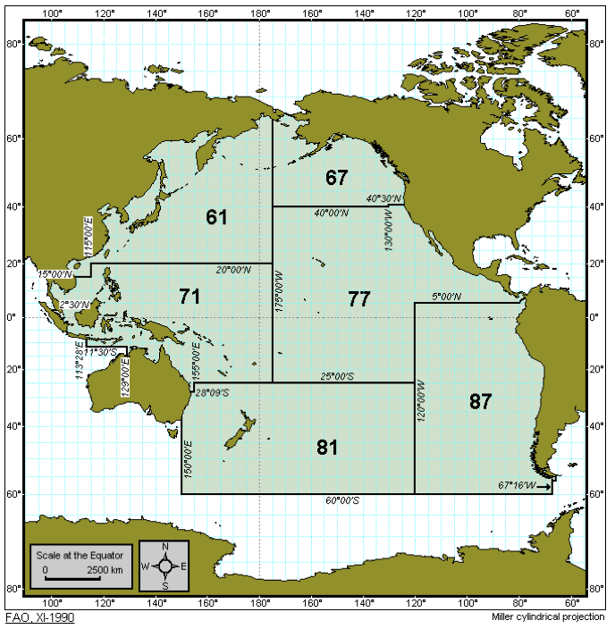
Fishery Indicators
FAO Region 61

Slide 7
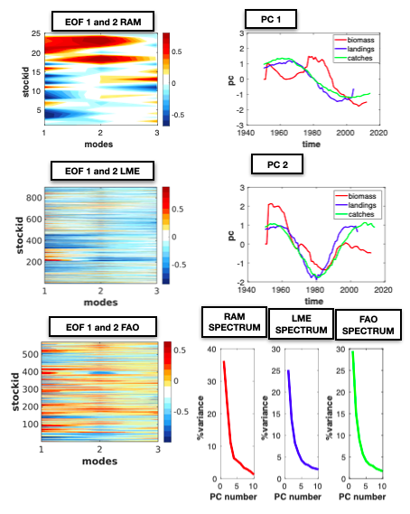
EOF analysis
RAM Data
RAM Data
LME Data
FAO Data
LME Data
FAO Data
RAM Data
LME Data
FAO Data

Slide 8
Fish Forecast
Uncoupled Case = the physics of North Pacific are independent of the tropics
RAM Data
LME Data
FAO Data

Slide 9
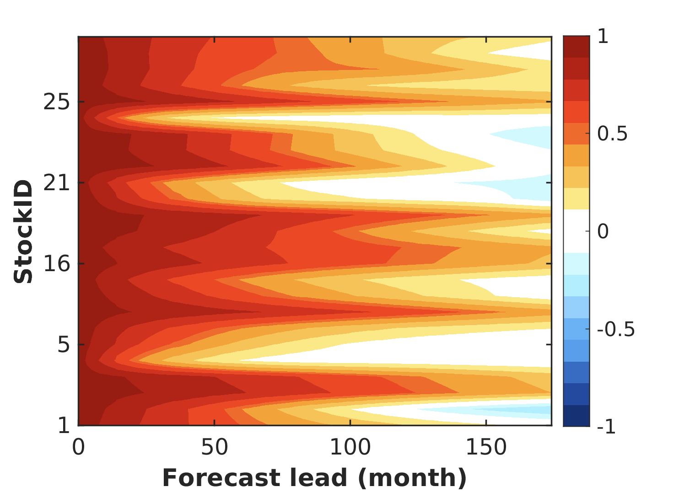
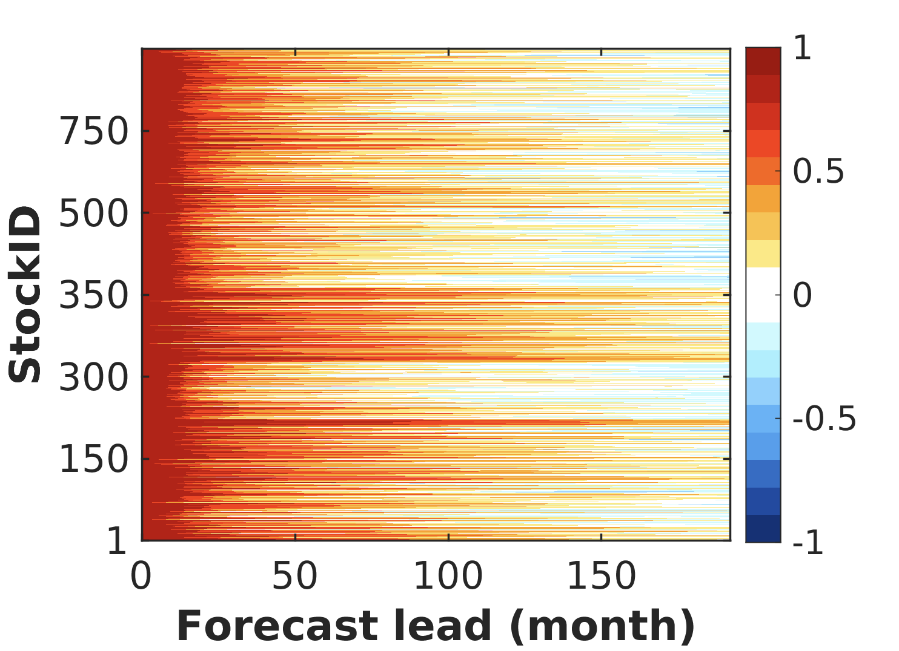
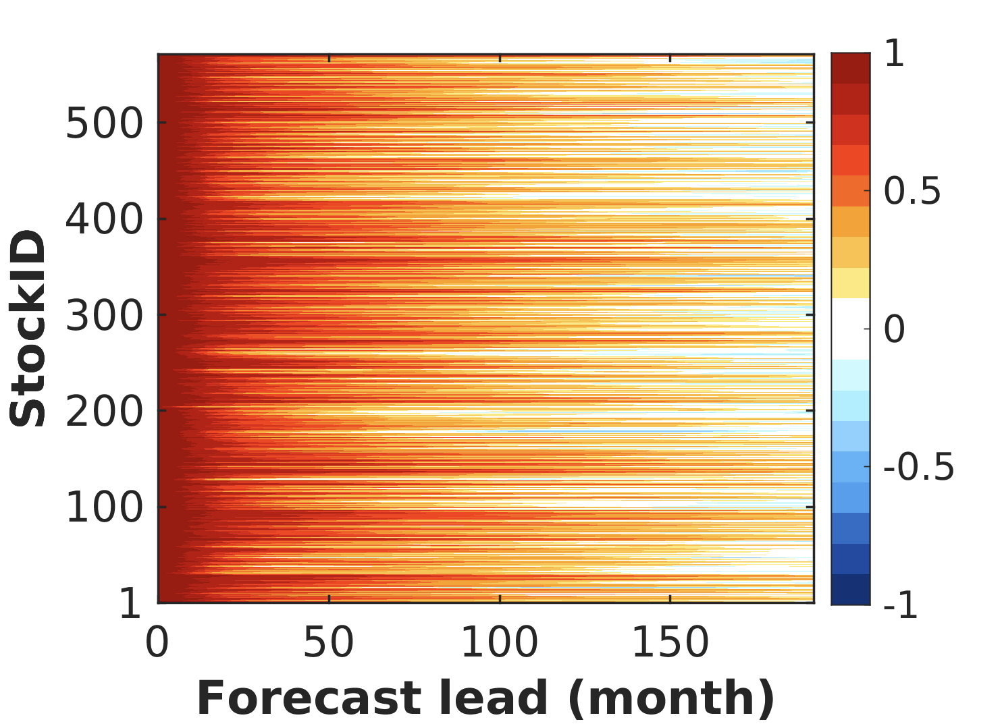
Fish Indicators Persistence skill
RAM Data
LME Data
FAO Data
Ocean anomalies can persist in a place for several days leading to physical predictability which we call
persistence. Statistically the persistence computed from the autocorrelation function.

Slide 10
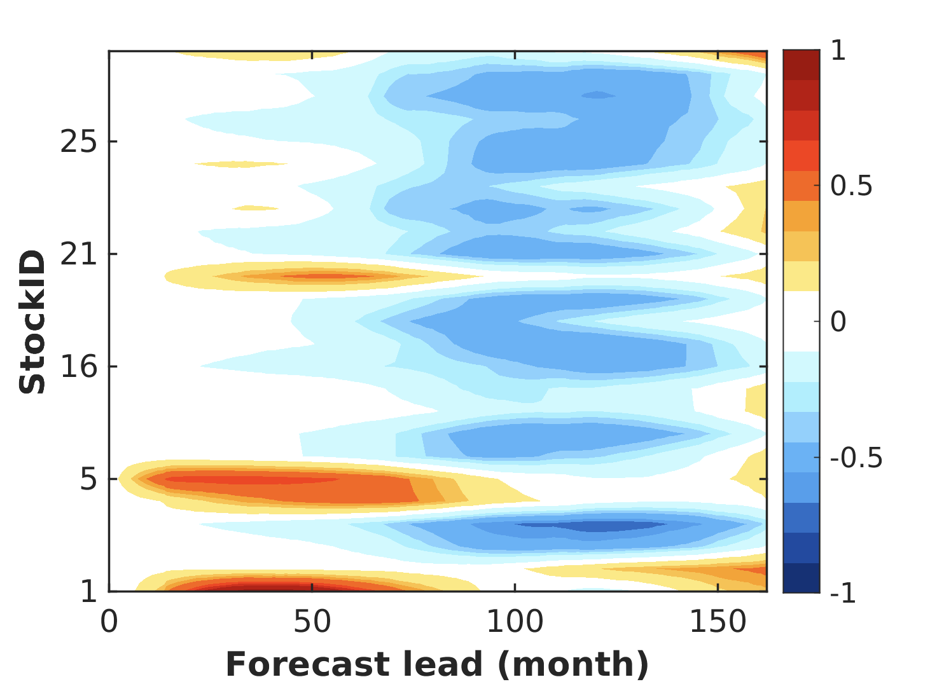
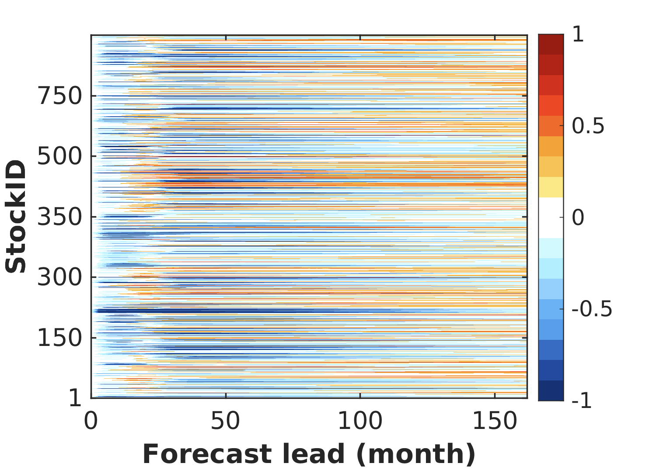
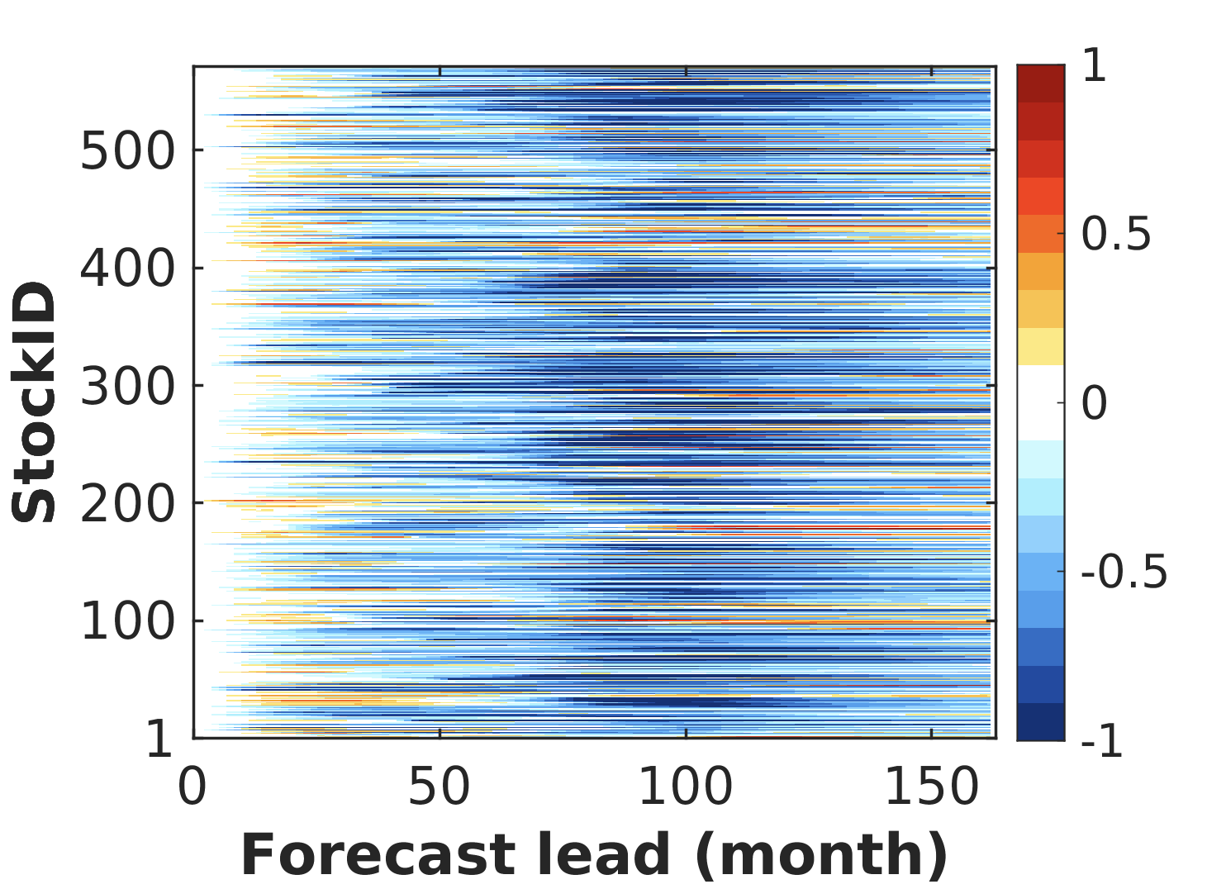
Comparing Fish LIM Forecast vs. Persistence skill
RAM Data
LME Data
FAO Data
Negative values = LIM Forecast is bad

Slide 11
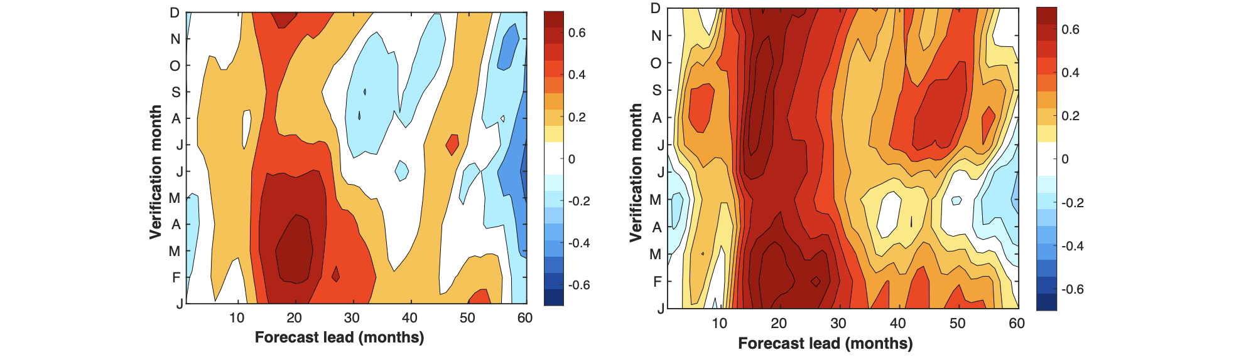
SST Forecasting skill increases with Coupling
Difference in SST Skill = Coupled – Uncoupled
North Pacific
North Pacific Only
Tropical Pacific
Monthly Raw Data
6-year Lowpass Data
Month of Year
Forecast Lead Time (months)
The coupling of the North Pacific with the tropics increases the physical forecasting Skill up to 1 year for the SST

Slide 12
Fish Forecast
Coupled Case = Tropical Pacific influences the North Pacific
RAM Data
LME Data
FAO Data

Slide 13
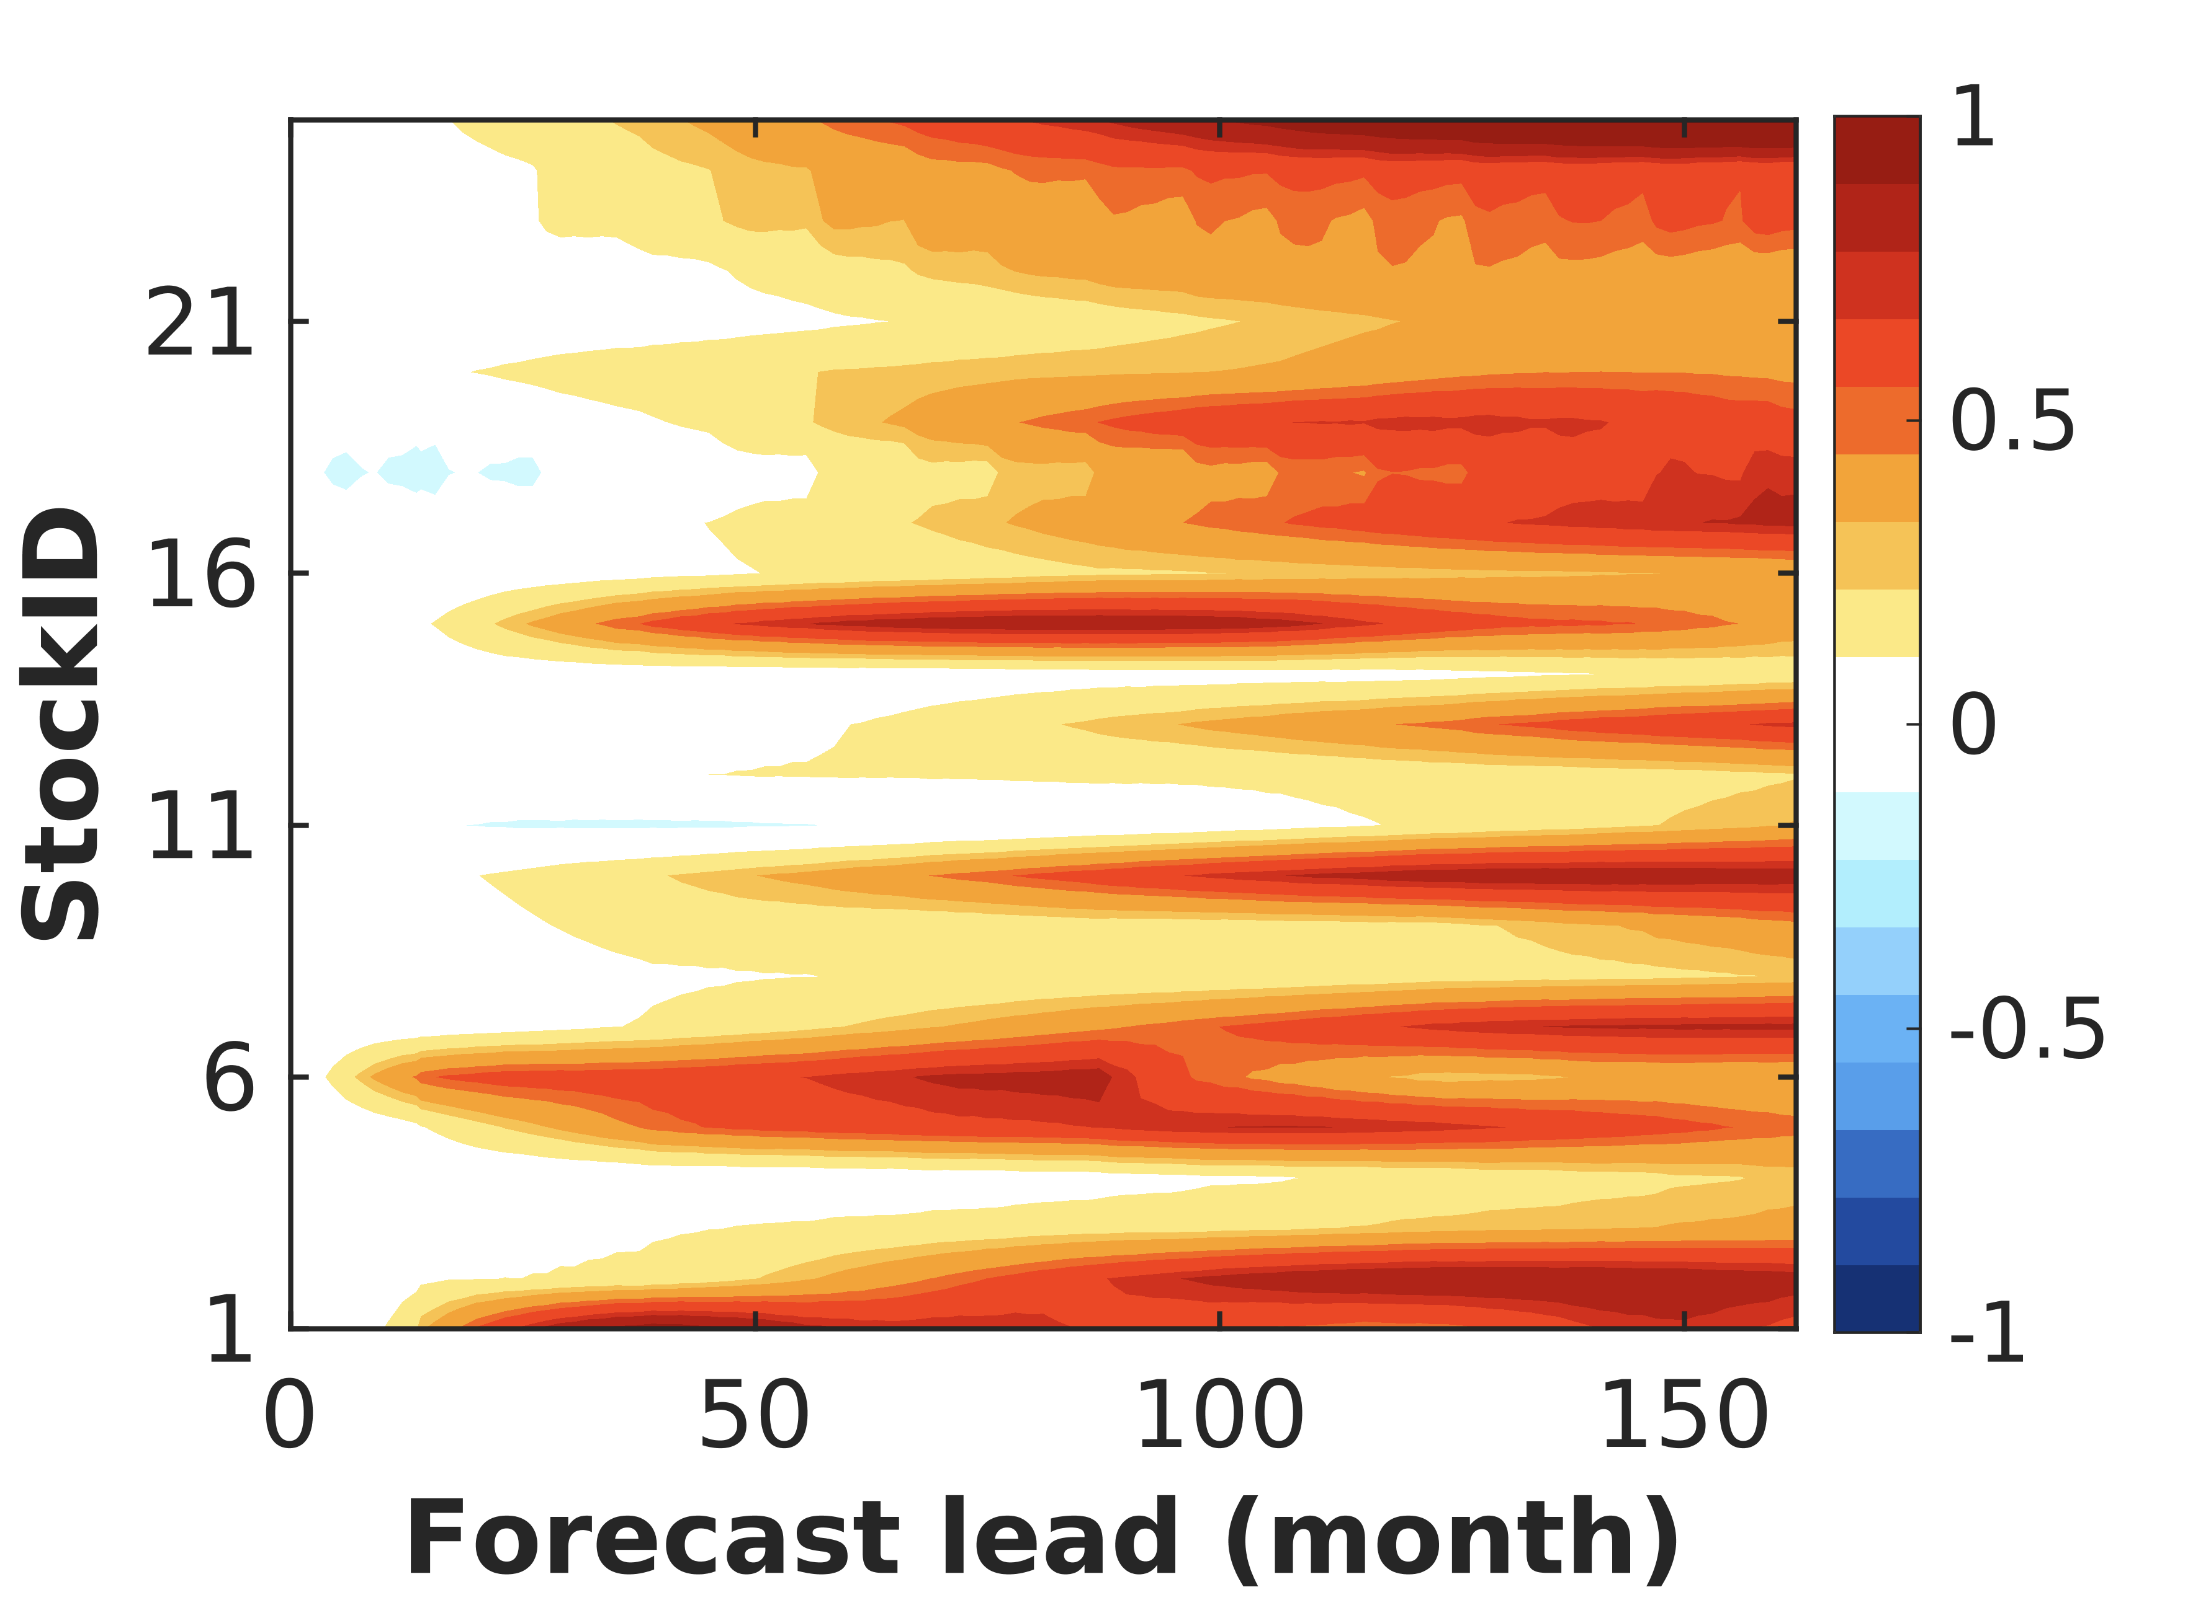
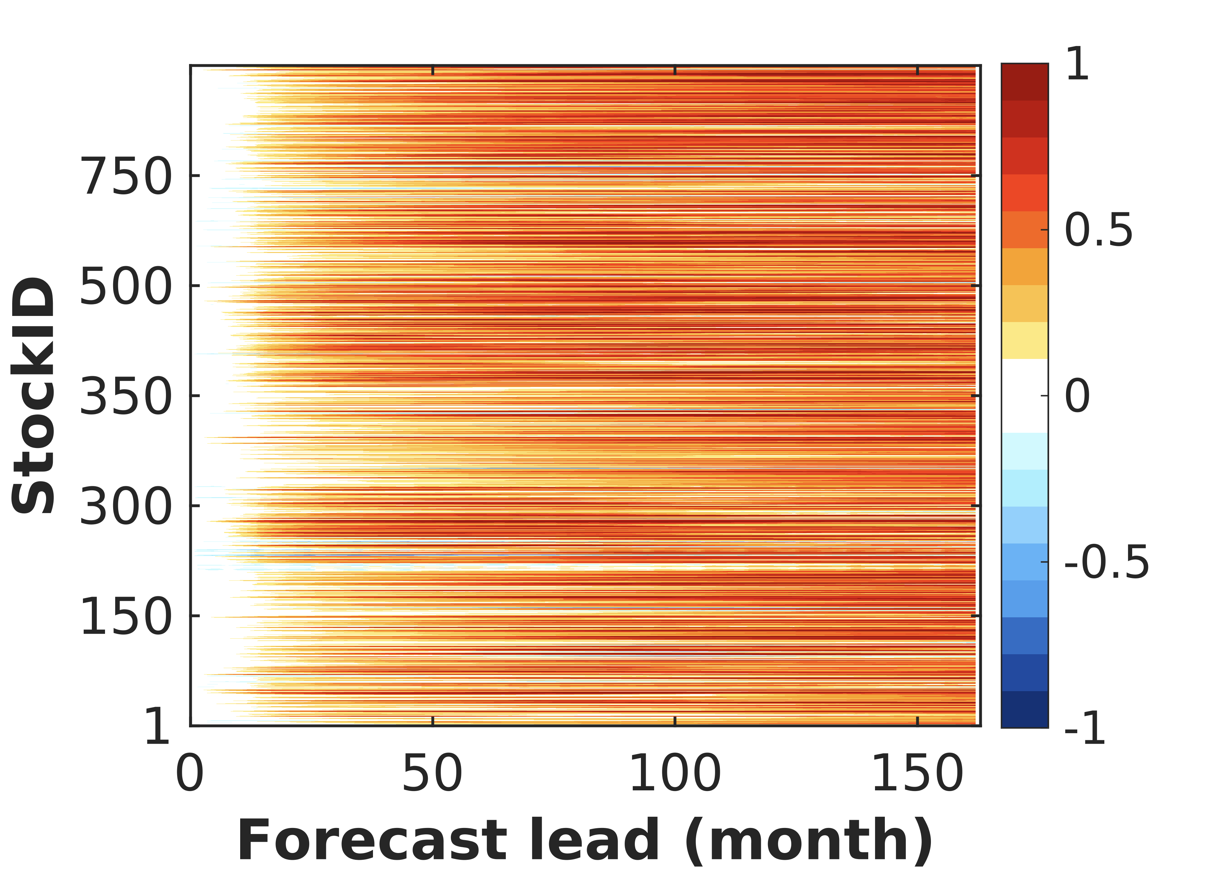
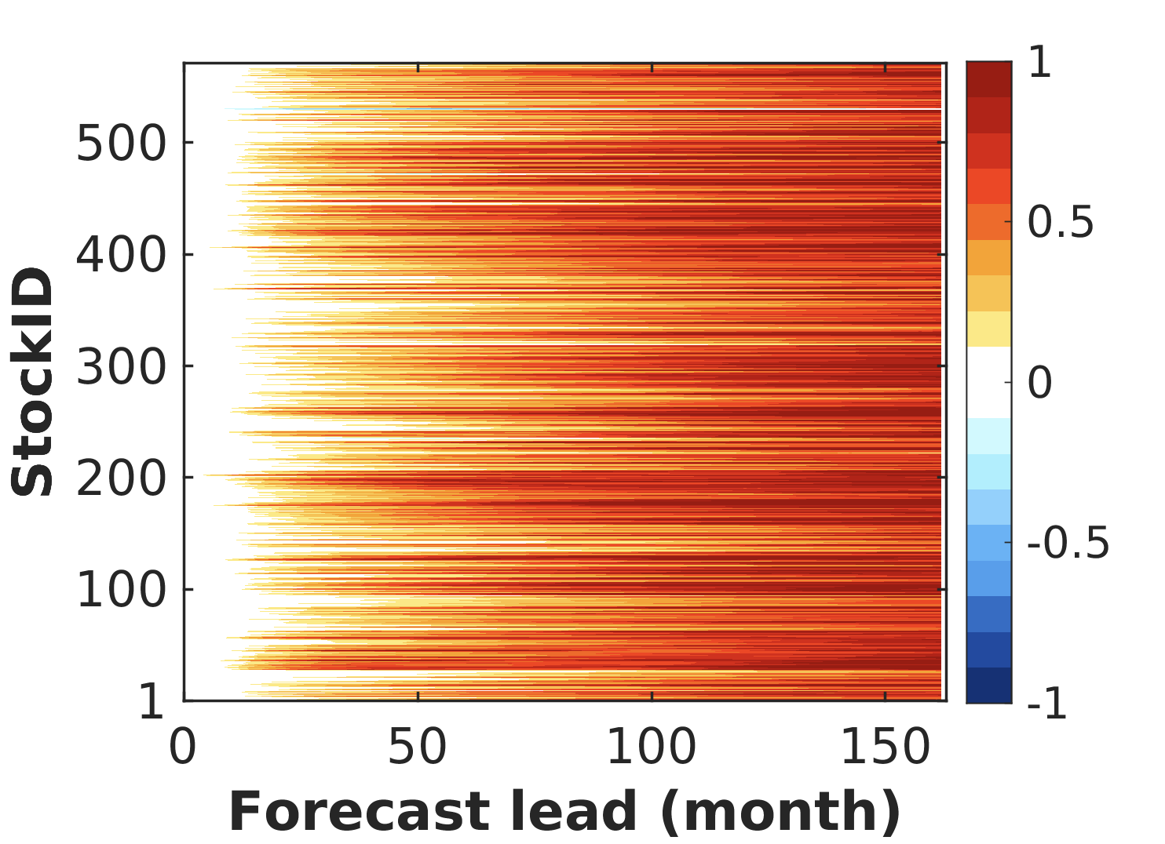
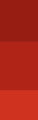
Improvement in Skill from Persistence
Fish LIM Forecast Skill – Persistence Skill
RAM Data
LME Data
FAO Data
Fish LIM is better than persistence

Slide 14
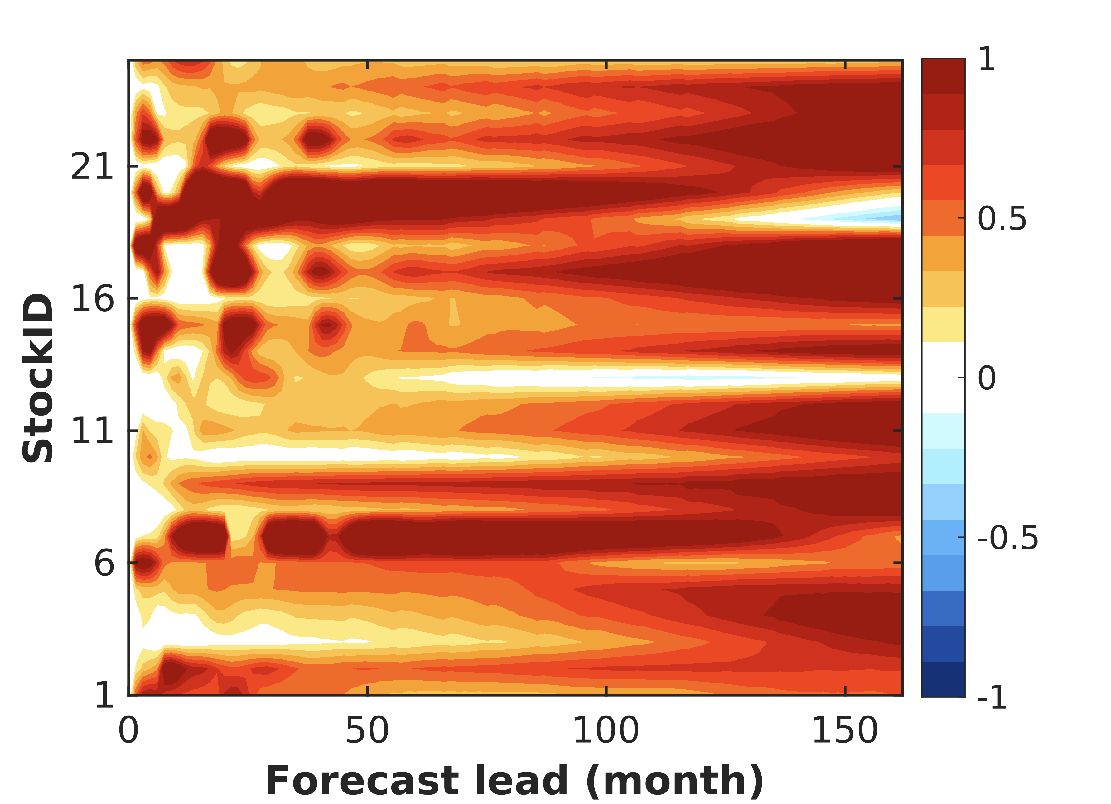
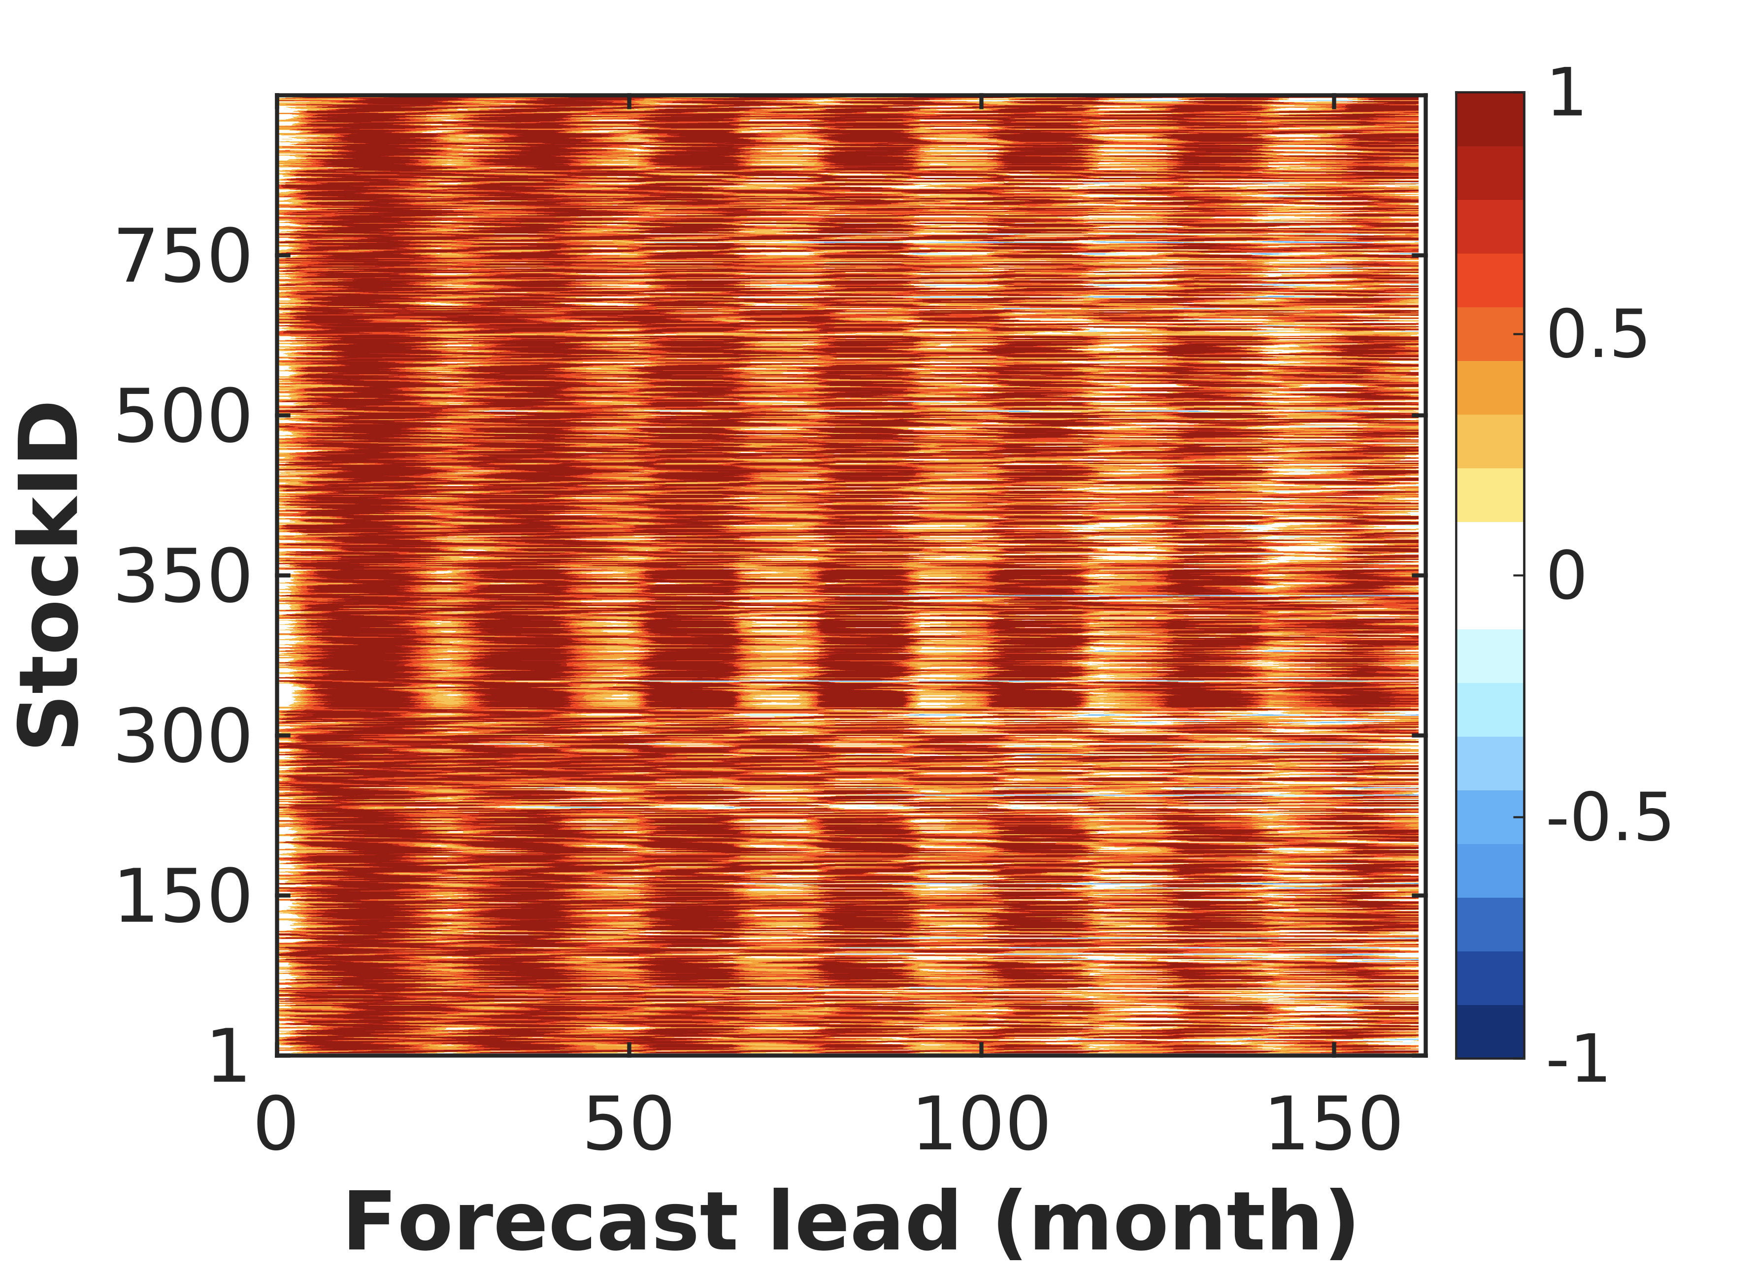
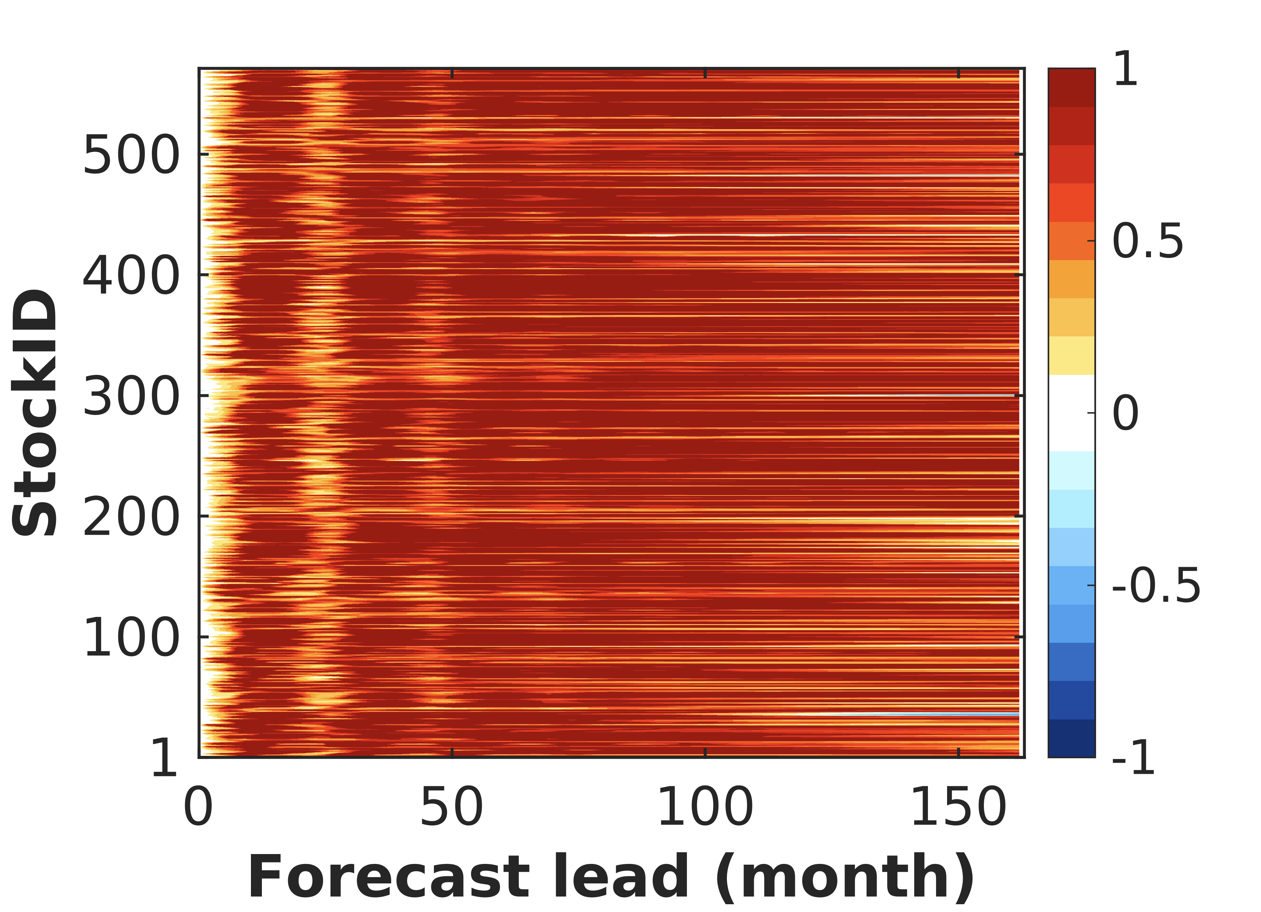
Contribution of Physics to the Fish LIM skill
Fish LIM Forecast Skill (all) – Fish LIM Forecast Skill (no physics)
RAM Data
LME Data
FAO Data
To confirm the impact of the physical part we re-run the LIM but setting to zero the interaction terms between the physical part and biology

Slide 15
Summary & Conclusions
-The Fish, SST, and SSH Linear Inverse Model is able to forecast Fish Indicators beyond the persistence timescale
-The physical coupling between North Pacific and Tropical Pacific is a key source of predictability for Fish Indicators
-Results from the Fish LIM will be compared to a Fish ML model.

Slide 16
Thank you for the attention.
Questions?

