Slide 1





Adoption and Implementation of Seagrass Essential Ocean Variables (EOVs)
Margot Hessing-Lewis¹, Angeleen Olson¹, Zachary Monteith¹, Carolyn Prentice¹, Luba Reshitnyk¹, Rebecca Martone^{1,2}, Kylee Pawluk², Markus Thompson^{1, 2}
1. Hakai Institute/Tula Fundation
2. Marine Plan Partnership for the North Coast (MaPP)
PICES 2021 Workshop: Monitoring Essential Biodiversity Variables in the Coastal Zone
Dr. Margot
Hessing-Lewis
Notes:
The Hakai Institute, together with MaPP – the Marine Plan Partnership for the North Coast - have been working on the adoption and implemention of macrophyte EOV’s for the past 3 years.

Slide 2
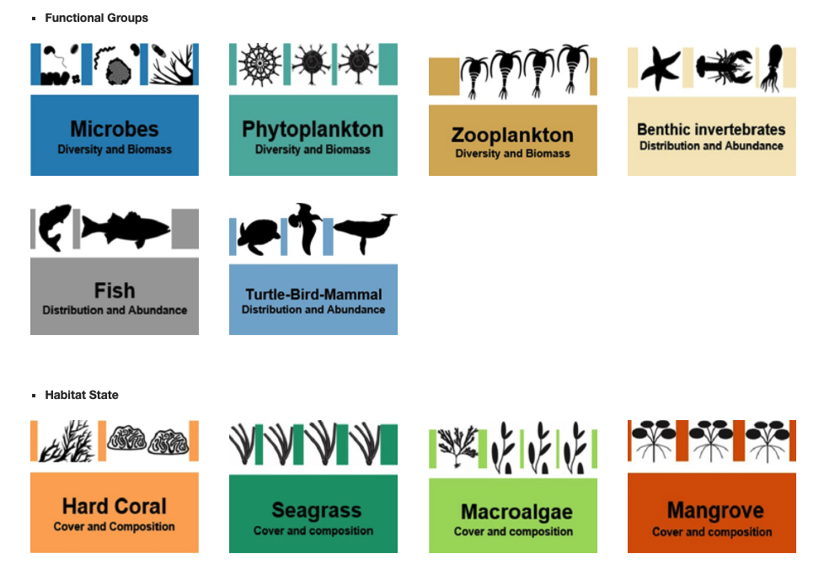
Essential Biological Ocean Variables:
GOOS BioEco Roadmap
Notes:
Seagrass was identified by the GOOS BioEco framework as a key ‘biological’ or ‘ecosystem’ variable, because of the important ecosystem services this habitat provides, as well as global mandates to improve management and conservation of this coastal habitat.
This talk will focus on seagrass, but our groups are also working on other functional and habitat variable, including macroalgae - specifically canopy forming kelps. Some of our key points with regard to EOV implementation carry over to kelps as well.
‘

Slide 3

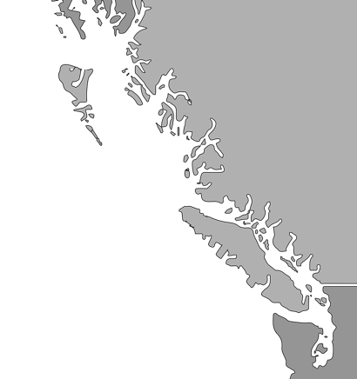

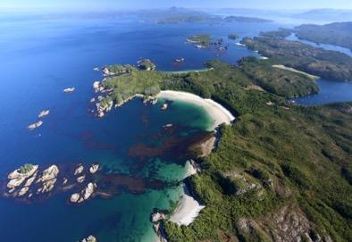


Informing local work with global standards
C-GRASS
Global
Regional
Local
Notes:
Our groups are working across local monitoring efforts,
regional networks and partnerships
And global initiatives
to implement seagrass EOVs
At the global level, members of our group are participating in C-GRASS, a SCOR-funded initiative
that’s working to support seagrass EOV/EBV initiatives under GOOS (the Global Ocean Observing System) and MBON (the Marine Biodiversity Observing System).

Slide 4
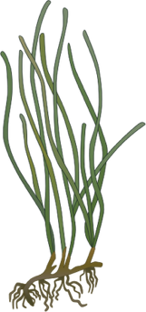
Seagrass Spec Sheet proposed EOVs to
GOOS (Global Ocean Observing Systems)
Sub-variables:
Seagrass cover
Areal extent
Canopy height & density
Seagrass composition (diversity)
Supporting variables:
Water clarity / turbidity
Temperature
Salinity
Epiphytic algae and fouling load
Complementary variables
Seagrass biomass
Seagrass disease prevalence
Algal abundance/biomass
Epifaunal abundance
Fish abundance & composition
Invert abundance & composition
Inorganic macronutrients
Notes:
One key task for C-GRASS is to review and find global consensus for proposed seagrass EOV’s
Following the GOOS nomenclature, seagrass EOV’s have been been organized into core sub-variables, supporting variables and complementary variables.
For each of these variables, guidance in terms of best practices for data collection and data management is in development

Slide 5
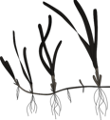

Seagrass EOVs
Local
Regional
Global
Seagrass cover
Seagrass composition
Notes:
There is already broad global consensus on two sub-variables: seagrass cover and composition.
These follow established methodologies through a number of global monitoring initiatives, including MarineGEO, SeagassNet and Seagrass Watch

Slide 6








Seagrass EOVs
Local
Regional
Global
Seagrass cover/extent
Seagrass composition
Seagrass cover/extent
Seagrass composition
Notes:
Locally, in BC, we are also using these key seagrass sub-variables as core components of our monitoring and research programs
For Hakai, long term monitoring of seagrass sites on the Central Coast, at our Calvert Island Obervatory, collects subtidal data on percent cover, spatial extent, as well as seagrass composition.
This data feeds into the MarineGEO Network and many other initiatives.

Slide 7
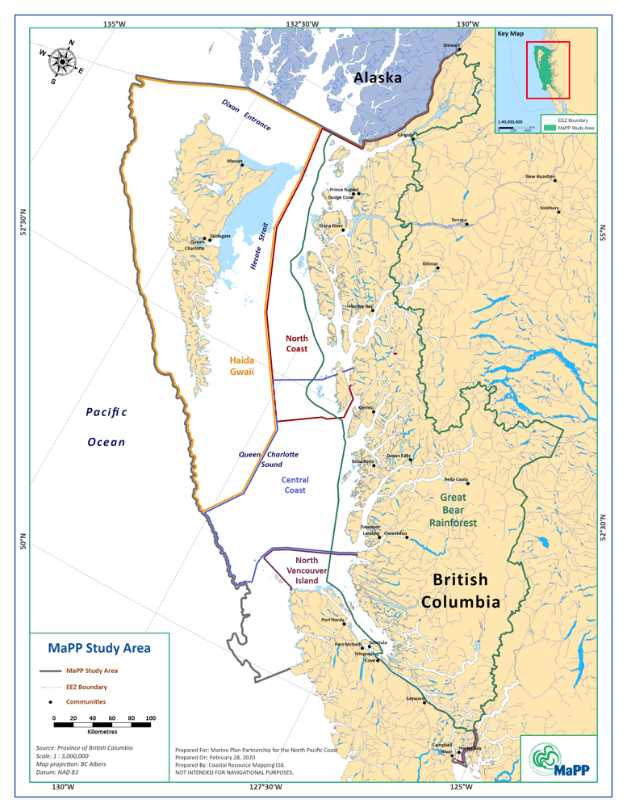
www.mappocean.org
Partnership between 17 First Nations and the Province of BC
4 sub-regional marine plans supported by a Regional Action Framework
Ecosystem-based monitoring goals:
  Protect marine environment;
  Promote sustainable economic development;
  Support coastal community well-being
Notes:
For MaPP, a partnership between 17 First Nations and the Province of BC
seagrass is a key regional and sub-regional indicator for ecosystem-based monitoring associated with 4 sub-regional marine plans.
Many First Nations stewardship offices have been leading seagrass and estuary monitoring initiatives across this region for the past 3 years
…………………………
Rebecca: I am a marine biologist with the Province of BC and presenting on behalf of the Marine Plan Partnership or MaPP. I would like to also acknowledge all of my colleagues that are on the call today.
MaPP is a partnership between 17 First Nations and the Province of BC. We work in the Northern Shelf Bioregion of BC in an area that stretches from Bute Inlet near Quadra Island north to the Alaska BC border and out to the continental shelf/slope. The group works to implement 4 co-developed subregional marine plans (Signed in 2015) and a regional action framework (signed in 2016) .
The plans and RAF are structured around an EBM framework and strategies and actions to protect marine env; promote sustainable ec dev and support coastal comm well-being
As part of this we monitor nearshore habitats across subregions and region to inform local and regional management decisions - we will speak more about those programs in the coming weeks.

Slide 8

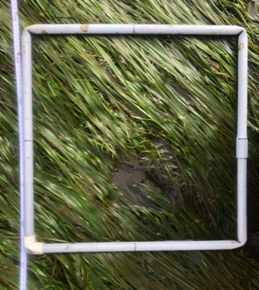
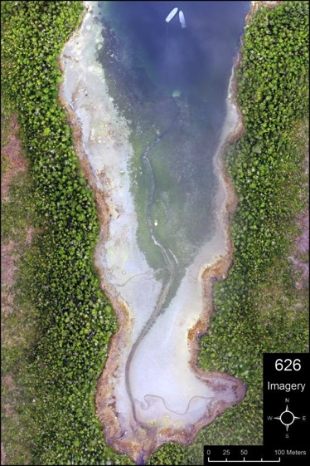
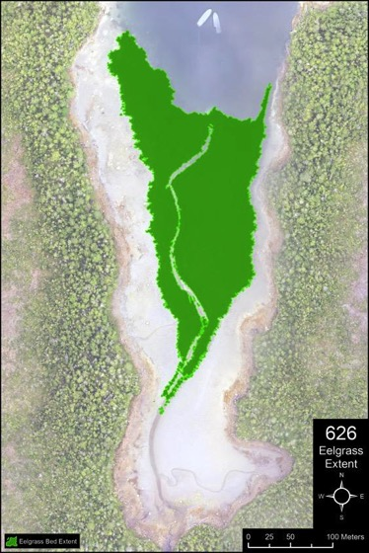
Implementing Core Monitoring Variables
Seagrass Cover
Sub-variables:
Shoot Density
Percent Cover
Areal Extent
Fish/Invert
Abundance & Diversity
Notes:
Seagrass EOVs have guided efforts to streamline and prioritize Hakai and MaPP monitoring efforts, with a focus on collecting sub-variable data, including density, percent cover and areal extent
To do so, our methods use on exisitng protocols for transect/quadrat surveys
And, importantly, new methods for areal cover using drones have been co-developed with Hakai and MaPP
The methods for seagrass drone flights and delineation of seagrass extent from this imagery will contribute to the international standards for seagass remotely sensed variables
Continuing with the seagrass example - EOV metrics and methods are currently in development.
They include parameters that we already measure.
For example the sub-variables include, shoot density and percent cover - surveyed at low tide or by SCUBA
We have well developed methods and training for this in BC currently - and some on the line are responsible for this!
But they also include areal cover, using new and emerging tools like UAVs (Drones) and other remote sensing tools.
One aim of this workshop series is to increase our collective fluency around these essential variables,
across a range of nearshore habitats.
And to have a dialogue around consensus for the priority variables to measure and how to standardize these.
As we’ve discussed, but to reiterate, we are also aiming to share existing and emerging methods for data collection,
thereby contributing to field training programs.
And to discuss the full data pipeline associated with habitat monitoring, using EOVs as the base data currencies..….

Slide 9
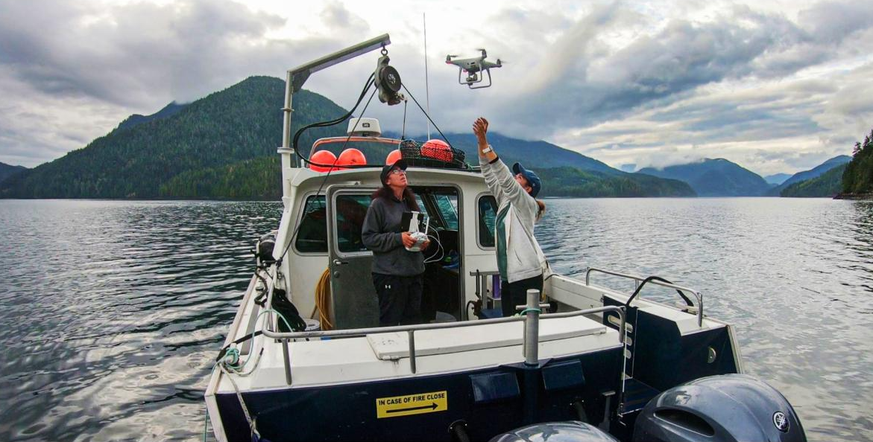
Notes:
A large component of our adoption and implementation work for seagrass EOVs includes training.
To this end we have been developing video modules for quick tips and how-to’s on various monitoring methodologies being used by MaPP partners.
The videos can be viewed in the field on a tablet, for easy access.
Thus far, our videos have focused on kelp EOVs, but we’ll be working to leverage our work on training videos with the international seagrass group in the future.

Slide 10

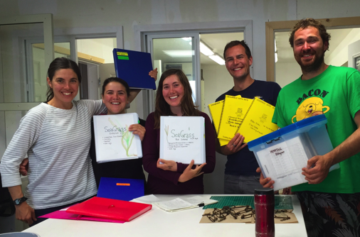
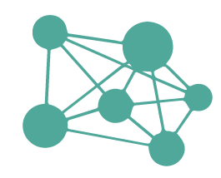

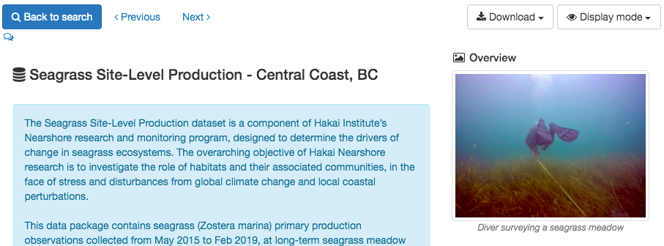
Local to global:
the data pipeline
Global metadata
(eg. GOOS, MBON)
Australian
Seagrass
EOVs
American
Seagrass EOVs
Field Data Collection
Canadian
Seagrass
EOVs
Data
Sharing and Integration
Regional metadata
portal
(eg. CIOOS Pacific)
BC
Seagrass
EOVs
Metadata Record
Hakai metadata
Local metadata (e.g. MaPP)
Data Management
Notes:
Another key component of our work in BC has been post data collection, working on the systems and platforms for data management, integration and sharing.
In this space, both Hakai and MaPP have been working on metadata catalogues, where datasets and data packages are made discoverable and accessible.
We are working on ensuring that our metadata portals in BC are set-up so that regional metadata, for example from Hakai and MaPP, can be harvested by CIOOS, the Canadian Integrated Ocean Observing System, which can subsequently be integrated with seagrass metadata from around the world through digital hosted by GOOS, OBIS and others
The data pipeline usually starts with data collection,
Then runs through the various stages of data management,
to data sharing and data integration.
Continuing with the seagrass example, the Hakai field team has collected data, QA/QC’d the data and produced a data package
A metadata record is produced that describes, in a standardized format, all the information associated with the seagrass cover EOV.
(Google ‘Hakai metadata’)
In this way, the metadata can be aggregated regionally with other EOV data in BC, such as that collected by MaPP.
The regional metadata portals can then be harvested by global metadata inventories, run by GOOS, MBON, etc.
Through this data pipeline, core ocean variables, collected locally, can applied to global efforts, including analysis of climate change, marine disease and invasive species spread….

Slide 11

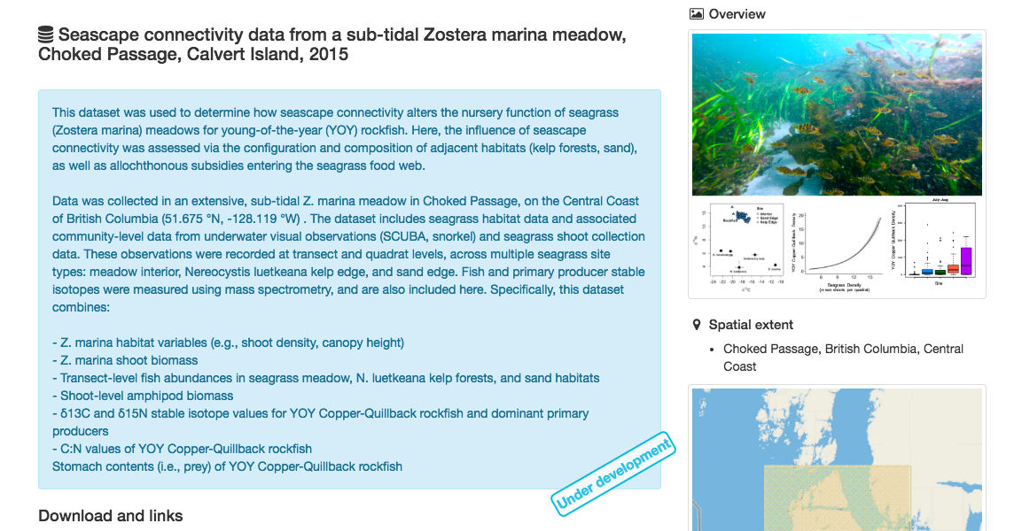
Example: Hakai Metadata
https://hecate.hakai.org
Soft Sediment
Seagrass
Notes:
As an example, here is one of our seagrass datasets
accessible via the Hakai metadata portal.
The information provided conforms to international metadata standards,
and comes with instructions for how to access the datasets.

Slide 12













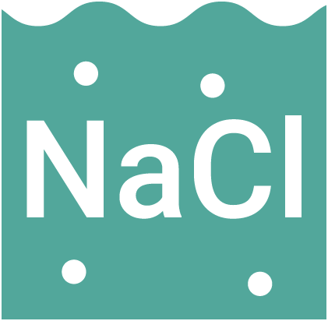




Essential Ocean Variables (EOVs) in CIOOS
Biochemical
Physical
Biological (Coming Soon)
Sea
Surface
Height
Notes:
Through all of this work, especially our data management tools, we are primed for onboarding of biological data to CIOOS,
This folllows the inital focus of CIOOS on more established biochemical and physical EOVs.
And, this aligns well with the global C-GRASS initiative, which has a number of key next steps:
………………
Essential Ocean Variables, or EOVs, are those that are mature in their methodology, standardized in the community, and widely collected. CIOOS is currently hosting data that were identified as widely useful to test the system. These include a selection of physical and biogeochemical variables and variables that may be derived from them. This list of EOVs is regularly expanding according to community interest and we are currently building capacity for many biological variables, including genomics, and making CIOOS compatible with existing repositories like the Ocean Biodiversity Information System, or OBIS, and the National Center for Biotechnology Information, or NCBI.

Slide 13
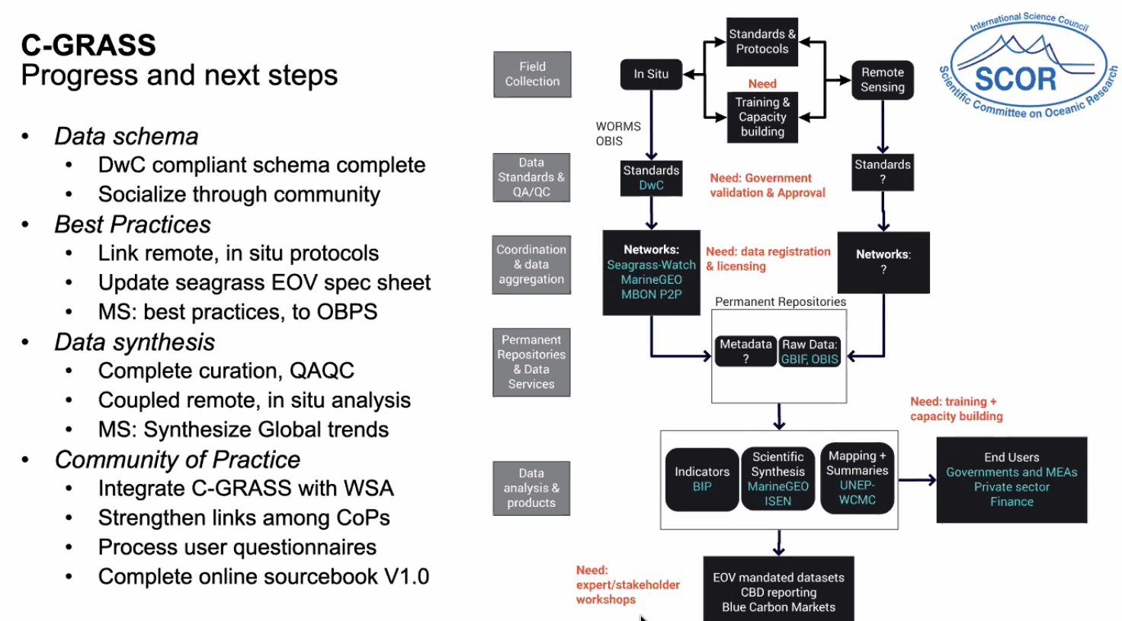
Towards “Essential Ocean Variables”
Notes:
These include:
Working out the kinks for a global seagrass data schema, including ensuring the data structure is Darwin Core compliant
Drawing links between remote sensing and in situ methods, and reviewing common methodologies appropriate across global monitoring programs
New syntheses on global seagrass trends from currently available data
And to round things out a global seagrass Community of Practice is being initiated.
One our their mandates is to gather and maintain metadata on the global observing network itself, starting with seagass, but expanding to other EOVs

Slide 14

Towards Seagrass EOVs (Essential Ocean Variables)
Local to global communications
ensure information on standards and methodologies is communicated at local, regional and international scales
Data management coupled with practice
importance of synchronous evolution of data collection
and data management
New tools for broad adoption of EOVs
development of new training tools and platforms
key for broad adoption and application of EOVs
Notes:
Looking forward, towards global implementaton of seagrass EOVs,
as well as other biological and ecosysem variables
There are a couple of key points to emphasize
First, we have been able to work across scales because of strong local partnerships, especially with Indigenous groups and communities, and also because of our work in international networks. This faciliates communication on standards and methodologies across scales, which will is key for local adoption of EOVs.
Second, Hakai has dedicated attention and funding towards data management, including iterative development between field-based scientists and computer programmers. And we’ve been able to leverage these technical skills for use by other organizations. We need more of this – system engineers and developers working in complement with those collecting the data.
Finally, especially in the era of Covid – new tools, such as the videos and apps I discussed, are important for supporting both emerging and established programs in the field. These can also be used to promote methodologies and get groups and individuals excited about contributing towards both local and global initiatives

