Slide 1
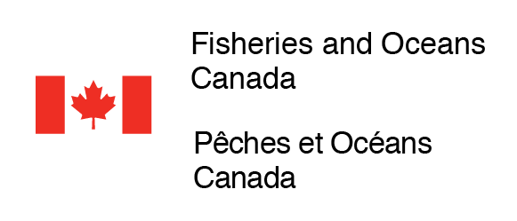
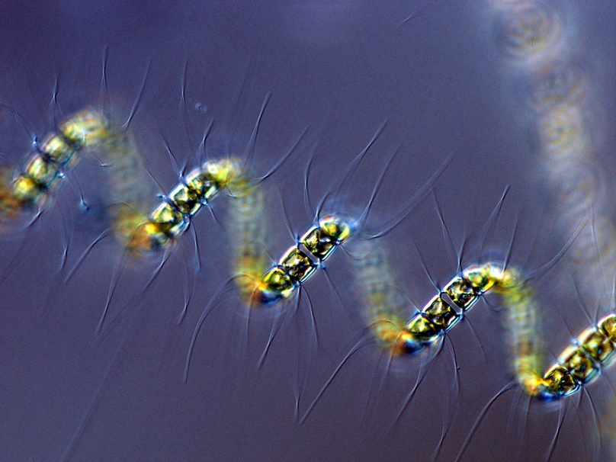
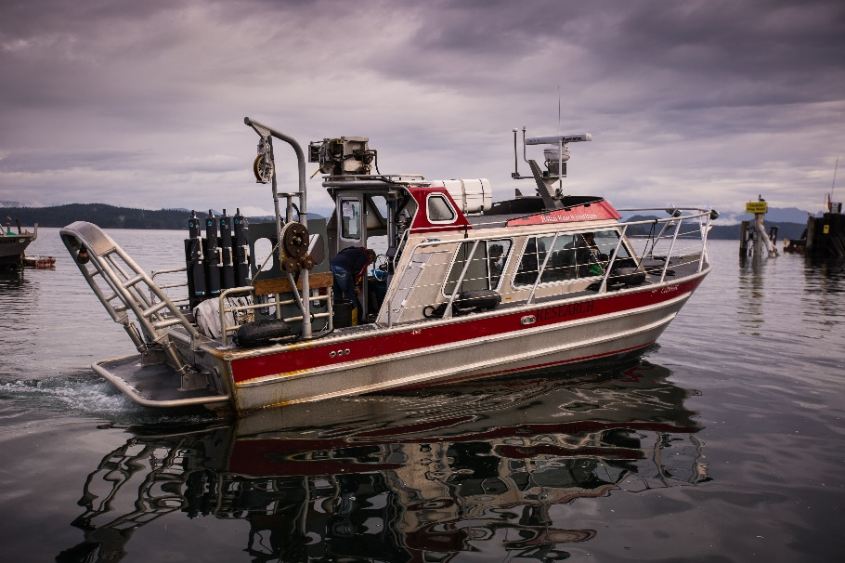
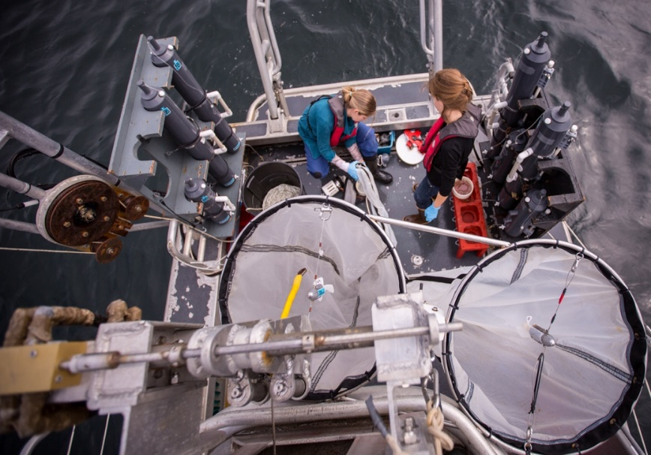
Phytoplankton Compositions and Environmental Drivers in the Northern Salish Sea
Justin Del Bel Belluz, Angelica Peña, Jennifer Jackson and Nina Nemcek
2021 PICES AGM
https://www.eoas.ubc.ca/research/phytoplankton/

Slide 2
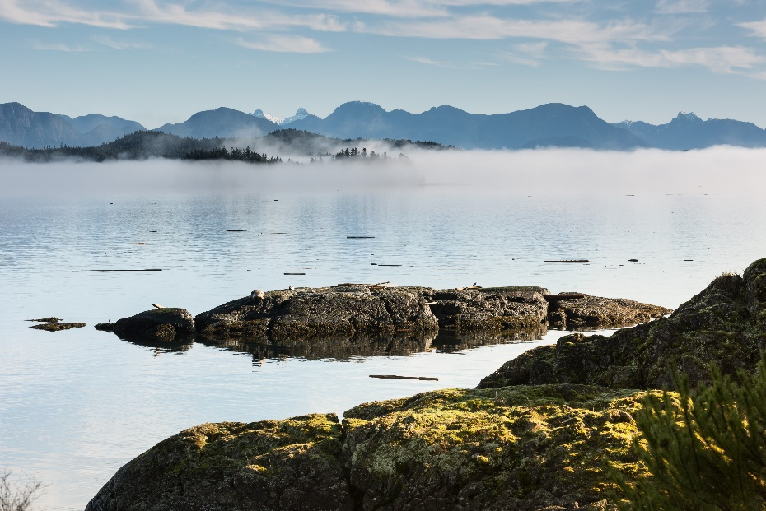
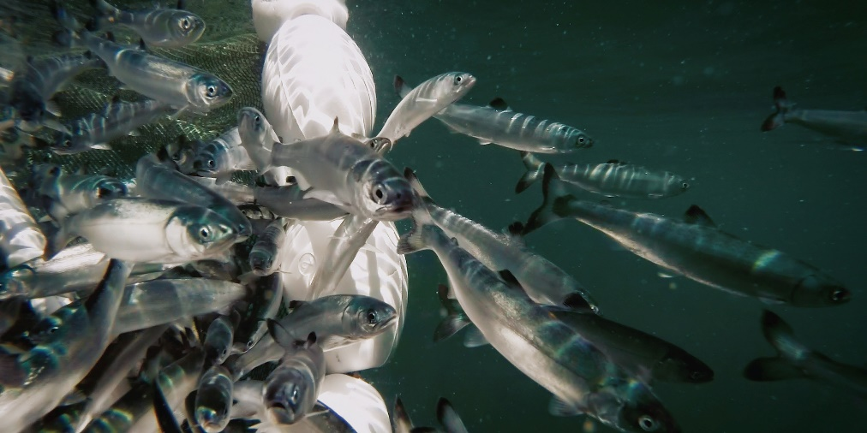
Objectives
To highlight the use of HPLC pigments for characterizing phytoplankton biomass, composition and environmental drivers in the northern Salish Sea using a high temporal resolution (weekly) timeseries.
Dynamic region that is crucial for fisheries.
2015-2018 results:
Del Bel Belluz, J., Peña, M.A., Jackson, J.M., Nemcek, N. (2021). Phytoplankton Composition and Environmental Drivers in the Northern Strait of Georgia (Salish Sea), British Columbia, Canada. Estuaries and Coasts. https://doi.org/10.1007/s12237-020-00858-2
Timeseries and analysis ongoing.

Slide 3
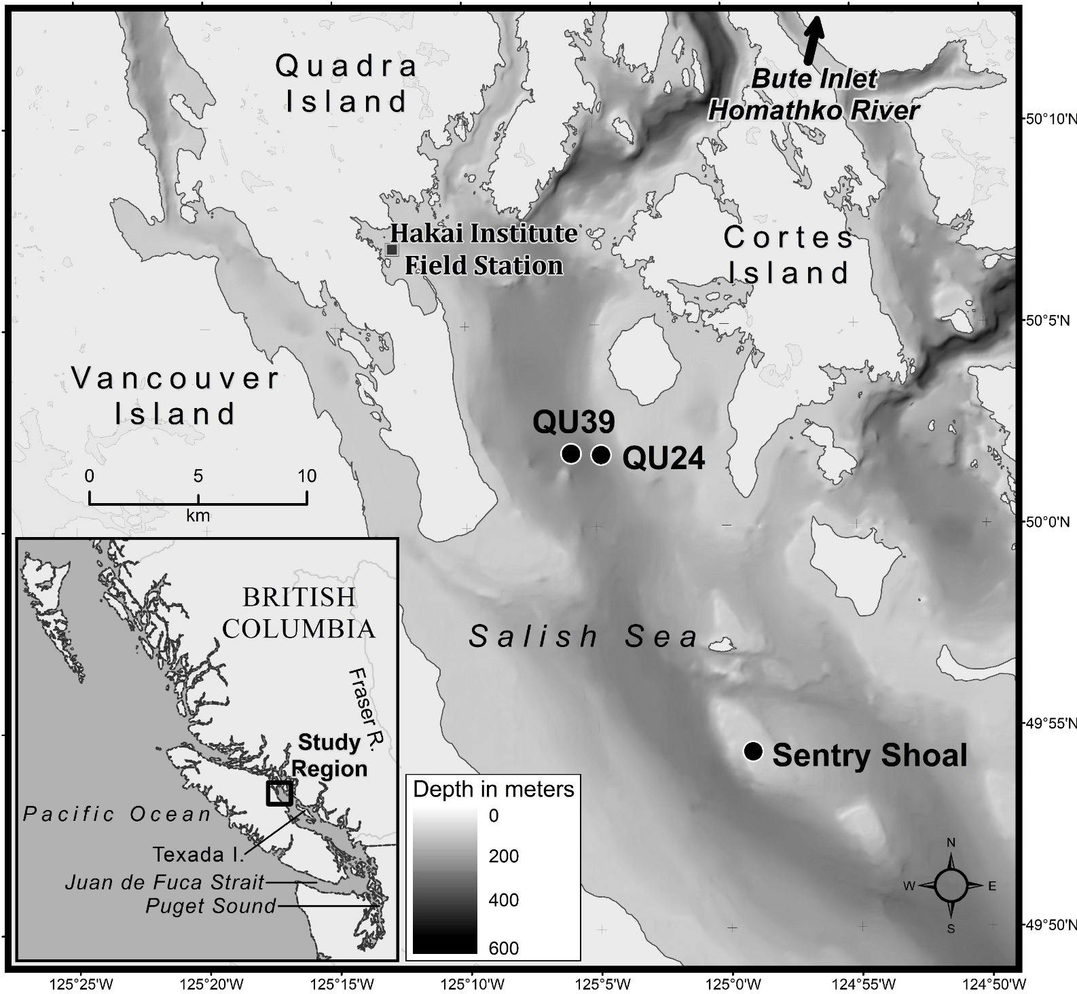
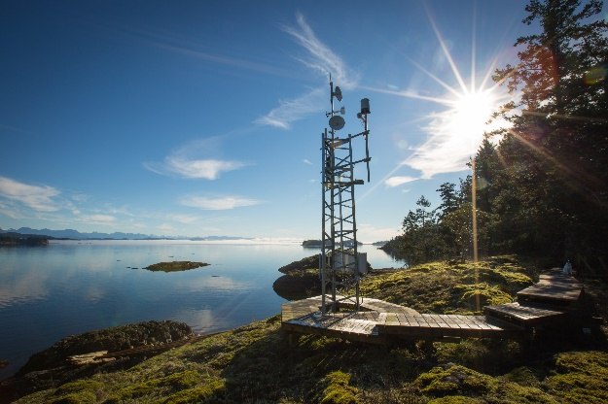
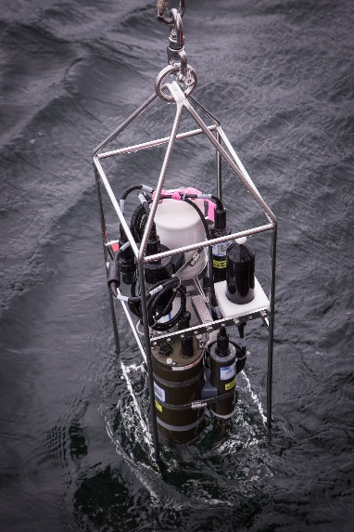
Study Region and Data
Timeseries at 5m depth:
Temperature
Salinity
Density
Nutrients (µM)
HPLC Pigments (mg m⁻³)
Microscopy at 0/5m depth
Protist counts > $\sim$ 5 µm (cells L⁻¹)
Incoming
Solar Radiation (W m²)
Wind (m s⁻¹)

Slide 4
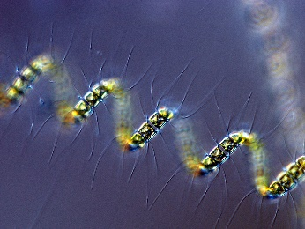
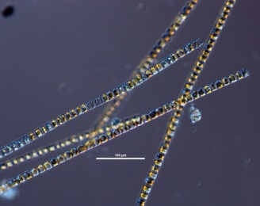
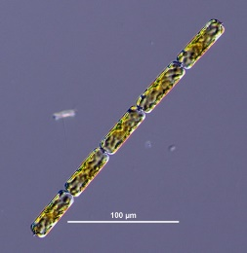
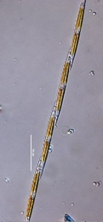
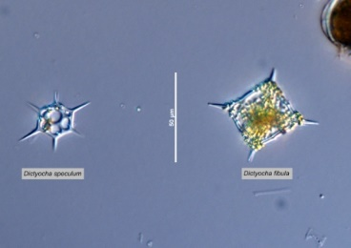
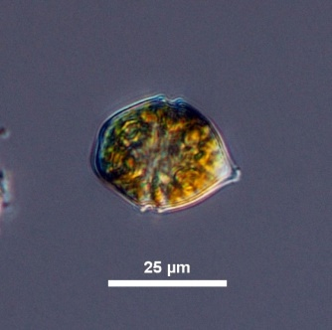
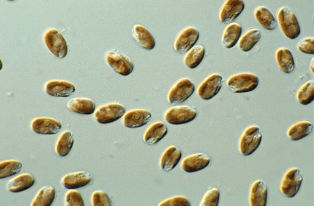
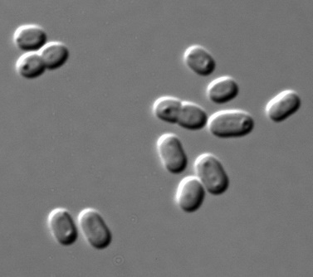
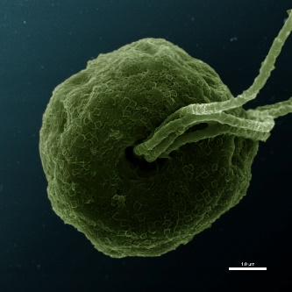
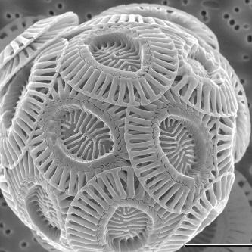
HPLC Phytoplankton Compositions
UBC
UBC
UBC
UBC
https://www.eoas.ubc.ca/research/phytoplankton/
HPLC Pigments (CHEMTAX)
Fast analysis
Consistent
Resolves pico-plankton
Group level biomass (mg-TChla m⁻³)
Microscopy
Used to guide pigment analysis
Genus/Species level abundance (cells L⁻¹)
UBC
Diatoms (Diat)
Dictyochophytes (Dict)
Dinoflagellates (Dino)
Cryptophytes (Cryp)
Prasinophytes (Pras)
Haptophytes (Hapt)
Cyanobacteria (Cyan)
UBC
CSIRO
Univ. Tsukuba – Nigaku-Ike
Taylor (2011)

Slide 5
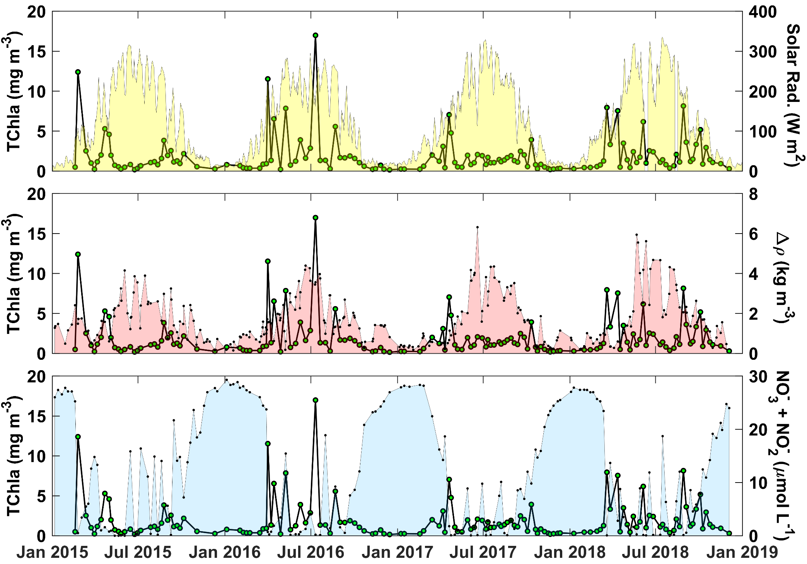
Results – Phytoplankton Biomass
Spring blooms:
Increased solar radiation and reduced wind.
Termination with nutrient limitation.
Post spring bloom:
Nutrient renewal from wind events.
Summer:
Reduced TChla and nutrients and higher stratification.
Nutrient renewal and drawdown not always met with increased TChla.

Slide 6
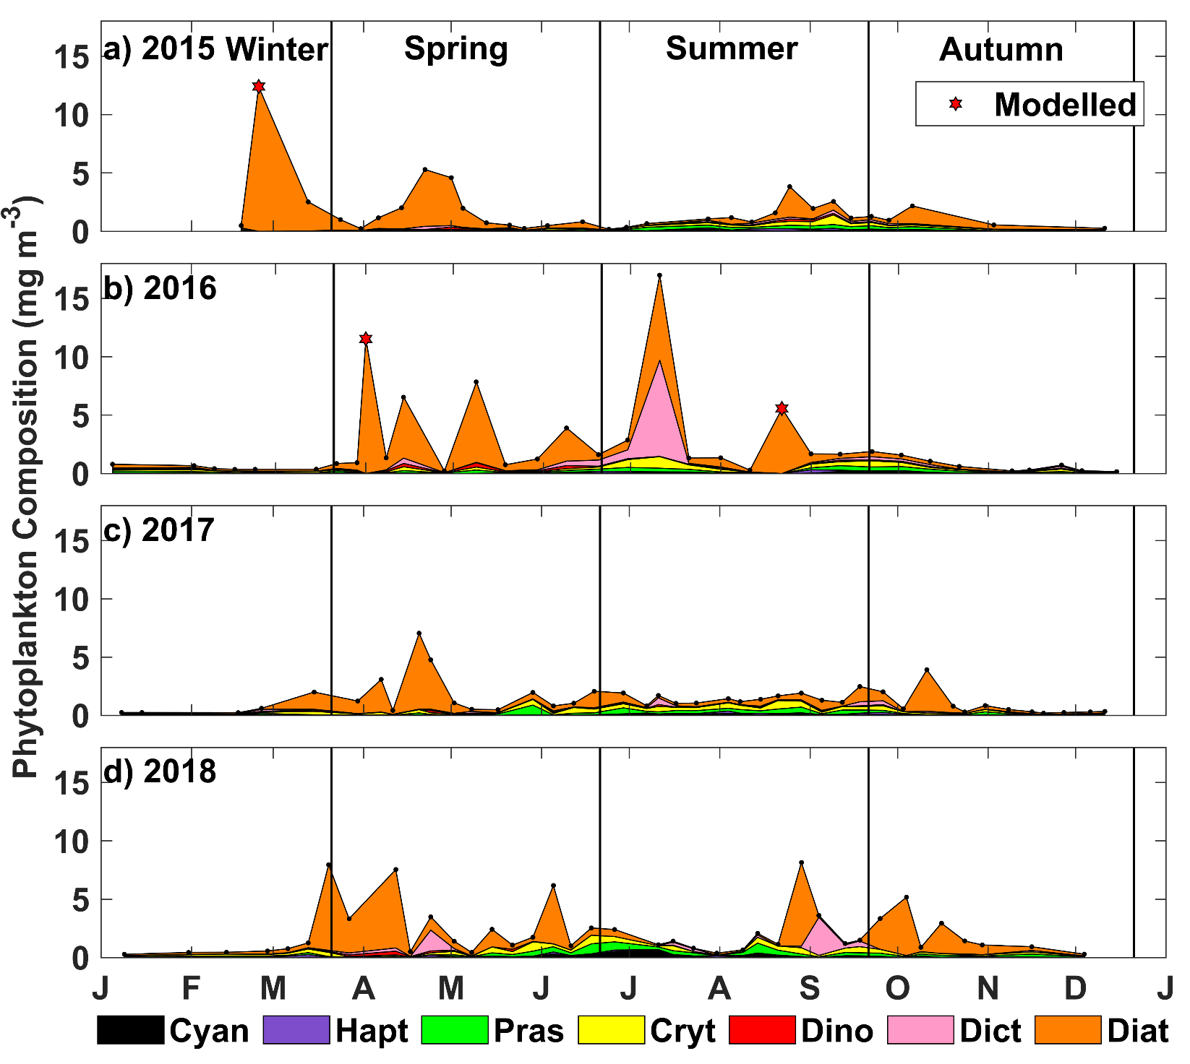
Results – Phytoplankton Compositions
Blooms dominated by diatoms, with exception to July 2016 Dictyocha (silicoflagellate) bloom
Late spring and summer – increased diversity dominated by cryptophytes, prasinophytes and cyanobacteria.

Slide 7
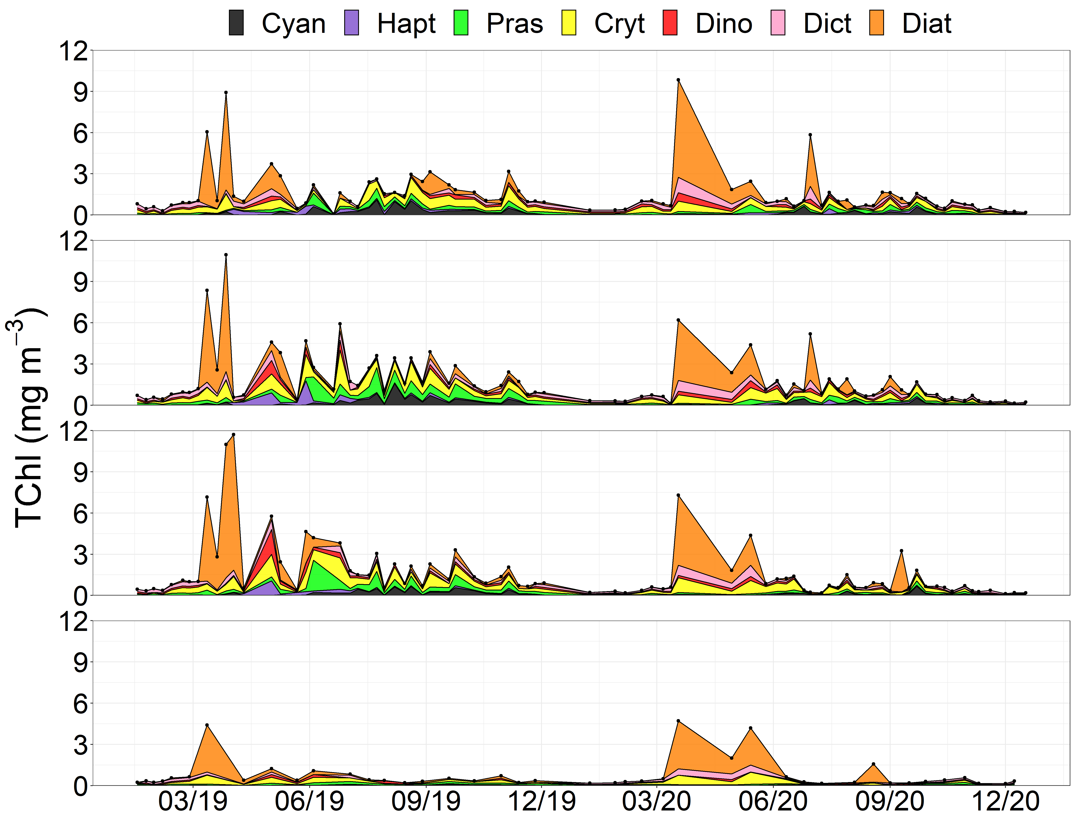
Results – 2019 and 2020 Vertical
0m
Outside of spring bloom, biomass constrained to upper 10m.
2019 - very high cryptophyte, prasinophyte and cyanobacteria biomass.
2020 similar to earlier years.
Late spring and summer persistently low in diatom biomass throughout six year timeseries.
5m
10m
20m

Slide 8
Databases and Public Availability
Status:
1) Phytoplankton Microscopy (2016-2018)
Submitted to GBIF - https://doi.org/10.15468/q748tc
Submitted to OBIS - http://ipt.iobis.org/obiscanada/resource?r=hakai_protistan_plankton_qu39&v=1.2
Data will be collected and submitted to the end of 2021
2) HPLC
Terms exist on BODC NERC vocabulary server (NVS)
Data could be incorporated into Canadian Integrated Ocean Observing System (CIOOS)
Commonly submitted to NASA’s SeaBASS data repository: https://seabass.gsfc.nasa.gov/naames
3) Chemtax
OBIS requires scientificName connected to World Register of Marine Species (WoRMS) LSID
Could submit HPLC with Chemtax ratios and parameters provided in metadata and publications

Slide 9
Summary
HPLC samples:
Easy to collect, quick to analyze, cost effective and provide a consistent method to monitor phytoplankton compositions in dynamic coastal environments.
Unlike microscopy, this method characterizes the entire phytoplankton community including pico-sized species and provides a proxy of biomass.
Allowed for in-depth monitoring of phytoplankton communities at high temporal and vertical resolutions in the Northern Salish Sea. The timeseries is ongoing and will provide greater insight with time.

Slide 10
Thank you!
Tula Foundation
All of the field technicians who have collected and processed the data through the years
Louis Hobson, Keith Holmes, Brian Hunt and Colleen Kellogg
Grant Callegari and Hakai Media/Geospatial

Slide 11
Journal Article Points
HPLC samples are easy to collect, quick to analyze, cost effective and provide a consistent method to monitor phytoplankton compositions in dynamic coastal environments. Unlike microscopy, this method characterizes the entire phytoplankton community including pico-sized species and provides a proxy of biomass. Furthermore, outputs of Chemtax analysis are used for validation of satellite retrievals of phytoplankton functional groups. As a result, HPLC is a valuable tool for monitoring phytoplankton community compositions and could represent an important EBV.
Ocean Biodiversity and Information System (OBIS) is the largest database of marine organism diversity, distribution and abundance and is part of the IOC-UNESCO International Oceanographic Data and Information Exchange (IODE). Hakai phytoplankton microscopy data have been submitted and are publicly available. Pipelines are in place for further uploads. OBIS is well suited for biological EBVs such as phytoplankton microscopy.
HPLC could eventually be submitted to the Canadian Integrated Ocean Observing System (CIOOS). Chemtax outputs may be difficult to submit to a repository, but if HPLC is available, the user can perform analysis independently based on published methods or information provided in the metadata record.

