Slide 1
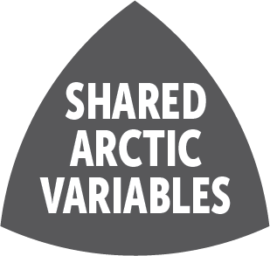





SAON-ROADS:
Governance-informed Planning for Polar Observing and
Data Systems
PICES - 2021
October 19, 2021
Sandy Starkweather
Executive Director – US Arctic Observing Network (US AON)
Chair – Sustaining Arctic Observing Networks (SAON)
Jan Rene Larsen
Executive Secretary – SAON
Correspondence: jan.rene.larsen@amap.no

Slide 2

SAON’s Scope, Vision and Mandate
“SAON’s intent as an open initiative is to unite Arctic and non-Arctic countries, Indigenous Peoples, academia, industry and other key organizations (e.g. WMO, GEO) in support of a systematic network[of observations and data systems] through structured facilitation”
Created as a joint body of the Arctic Council and the International Arctic Science Committee (IASC) under the Nuuk Declaration (2011);
Recognized by the Arctic Science Ministerial process as a critical capacity for “moving from design to implementation of the Arctic observing system.”
Recognized by the Arctic Observing Summits as needed leadership entity to assist with network planning.

Slide 3
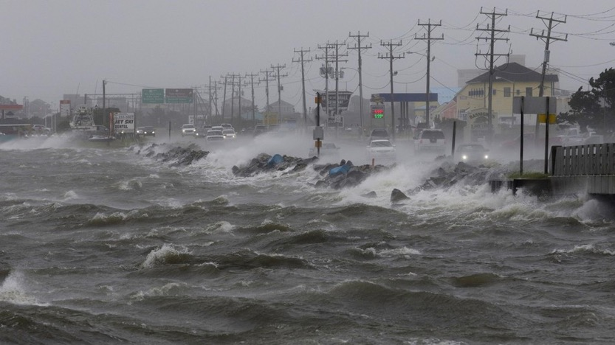
Why do we need SAON-ROADS?
Arctic changes are unprecedented
Observations inform actions in the face of these changes
Systemic issues (planning, engagement, deployments) at the Global, Regional and Local scale impede progress
SAON has been given a mandate to facilitate planning – ROADS is the tool.

Slide 4
ROADS Guiding Principles (polycentric!)
Indigenous Peoples’ equitable partnership and funding for their active participation is critical to ROADS;
All aspects of the ROADS process should support broadly shared benefit from the observing and data systems;
The ROADS process should complement and integrate the current planning approaches used by existing networks (regional to global), activities and projects;
ROADS should support stepwise development through a flexible and evolving structure that allows grassroots identification of foci.

Slide 5

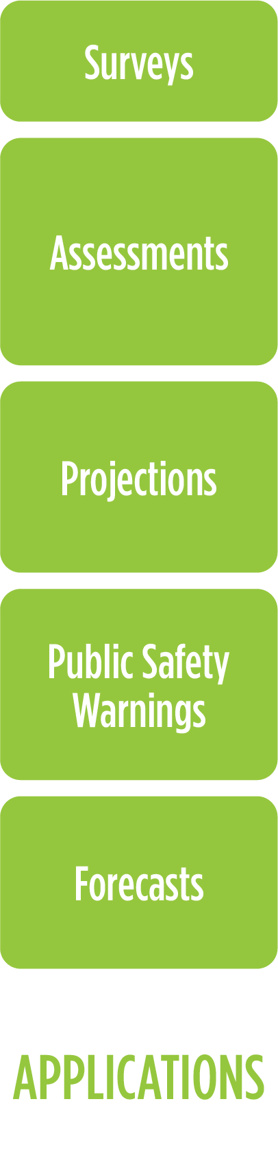

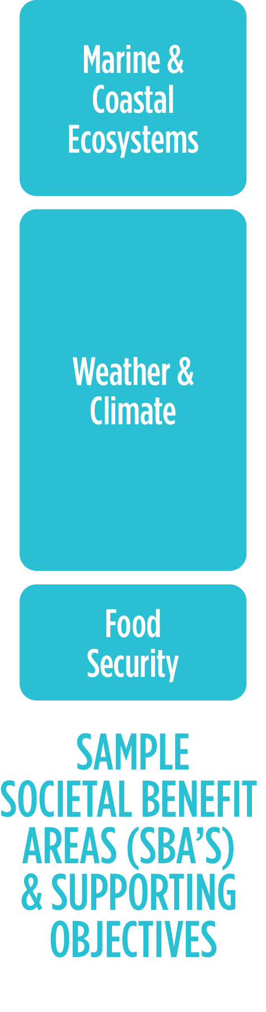



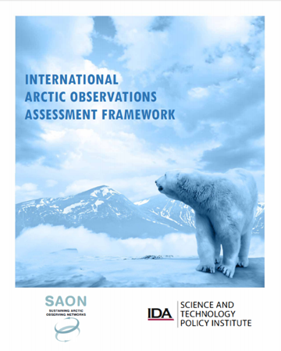
ROADS Benefit Assessment: Value Tree Analysis

Slide 6



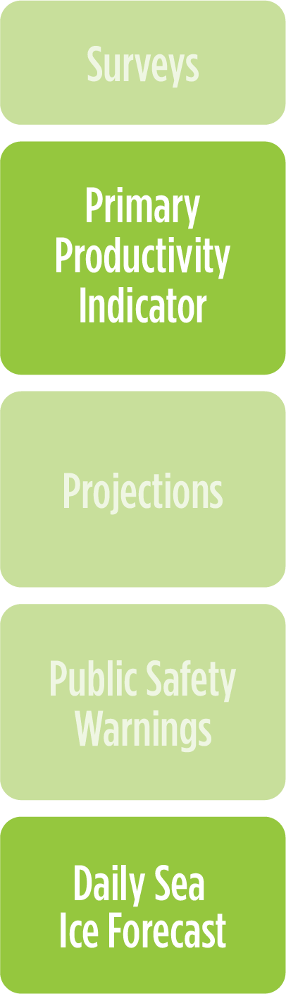

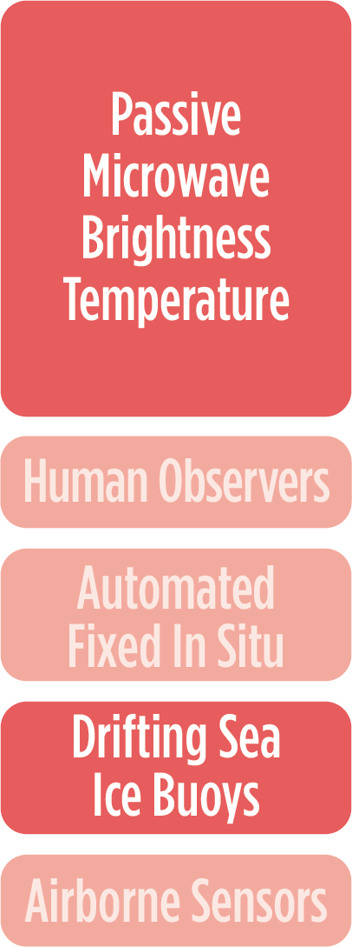

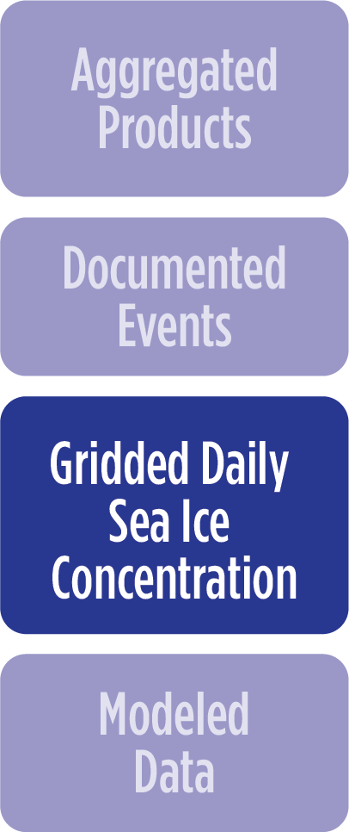
ROADS Benefit Assessment: Value Tree Analysis

Slide 7
Shared Arctic Variables
Indigenous-led
Benefit Identification &
Observing Strategies
Regionally-identified Science & Decision Making Needs & Observing Strategies
A critical capacity for assuring that the outcomes of ROADS and its implementation are relevant to Arctic communities and the outcomes are well-linked to culturally-informed decision making.
Regionally-led priorities driven by scientific understanding of the Arctic System and the specific decision-making needs from cascading changes within the Arctic System.
Essential Variables of
Global Networks
High-capacity partnerships that link the Arctic and the ROADS process to the global system and interests.

Slide 8
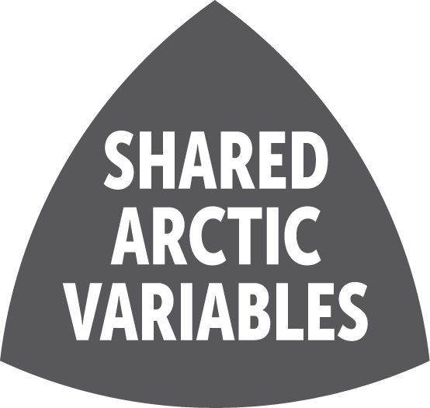
Variables add Coordination to Value Tree Analysis

Slide 9
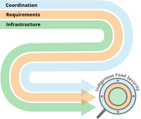

Research Networking Activity (RNA)
Coordinated Observations of Arctic Change (Arctic CoObs)
Contacts:
Hajo Eicken (PI) – heicken@alaska.edu • Maureen Bierman, coordinator
Craig Chythlook, Margaret Rudolf, Victoria Buschman (Food Security WG Liaisons) Raychelle Daniel & Indigenous Liaison
Hank Loescher – Design Development Lead
An Nguyen – Observing System Design/Simulations Lead
Amber Budden – Information Infrastructure Lead
Craig Tweedie, Bill Manley – Polar Observing Assets Working Group
Peter Pulsifer – SAON Arctic Data Committee
Sandy Starkweather – US-AON & SAON
Support:
NSF, Arctic Observing Networks Program • NOAA Global Ocean Monitoring & Observing Program • Pew Charitable Trusts • International partners: AINA, NIPR, AWI & others

Slide 10
RNA CoObs Approach
Coordination & Collaboration
Meetings, Interviews, Workshops
Requirements Framework
Through meetings, collaborations, and close partnership with the AOS Food Security Working Group, we will design or adapt information infrastructure
* Show how internationally coordinated roadmap for Arctic observing can be designed and developed
*Support food security information in Pacific Arctic & pan-Arctic
Design Development
Information Infrastructure

Slide 11
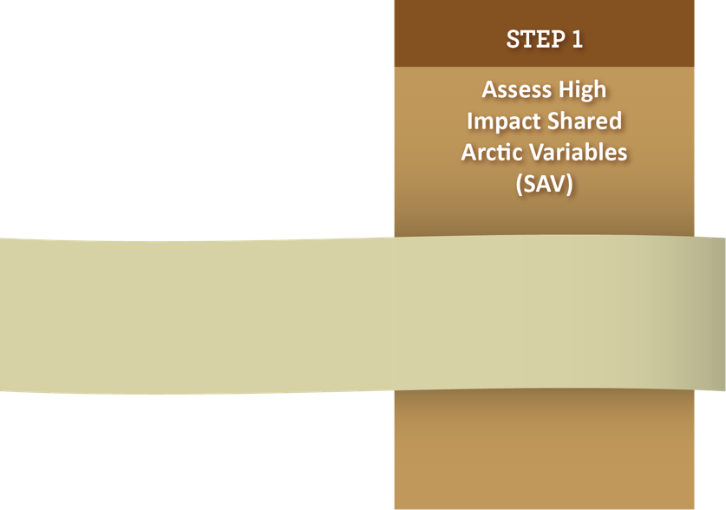
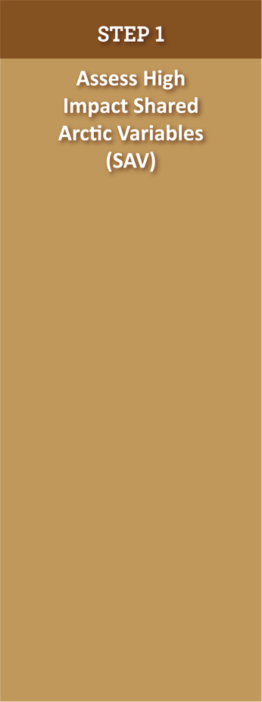

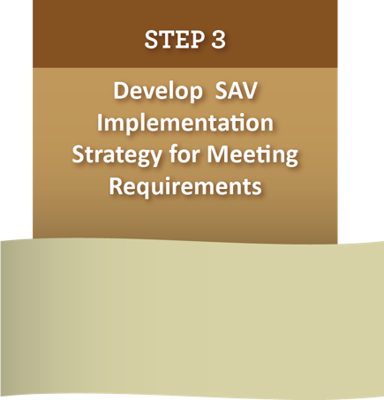
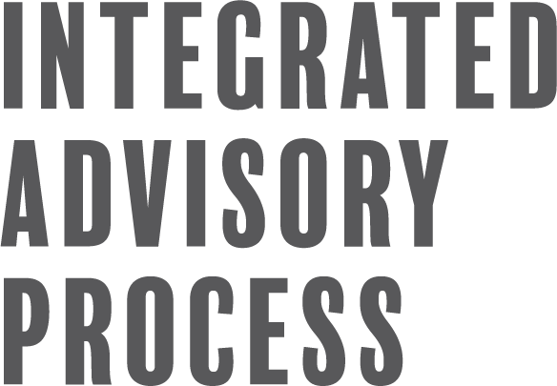






E.g. RNA Co-Obs
Wellbeing & Food Security in Bering
and Adjacent Seas
Regional Expert Panels
Thematic Expert Panels
E.g. Ocean Acidification
Pan-Arctic component of
Global Ocean
Acidification Network
Issue-Driven Expert Panels
E.g. Marine Plastics
Monitoring strategy for AMAP’s Expert Group on Marine Debris

Slide 12




Governance-informed Obs/Data
Planning Needs of Relevance to PICES
Adopt flexible planning tools that recognize polycentricism and drive meaningful convergence link many centers.
Identify policy mandates that generate adequate authorities, and tools to get the organizations with those authorities to collaborate.
Cyberinfrastructure and soft policy bodies to glue many centers together; on-going communication,
engagement vehicles drive it forward.

